Slide 1
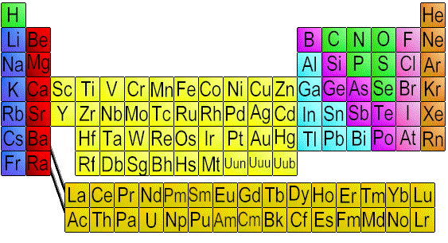
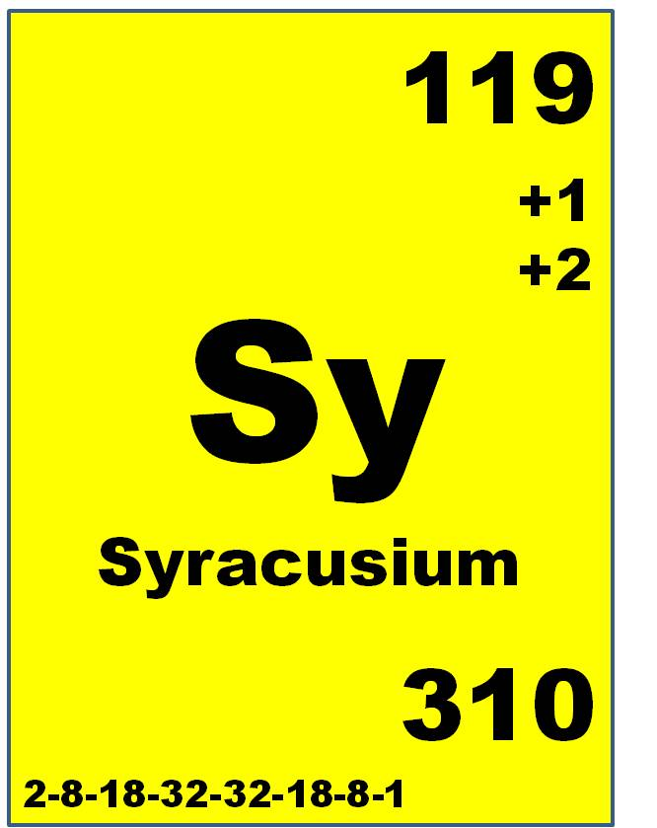
Name ___________________________________________ Date ________________ Period __________
Part I: No yelling at the table

Slide 2
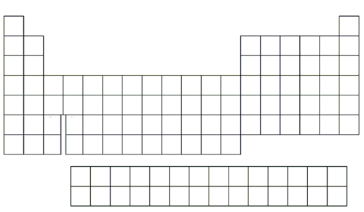
Ionization Energy
Atomic Radius
Electronegativity
Metallic Character

Slide 3
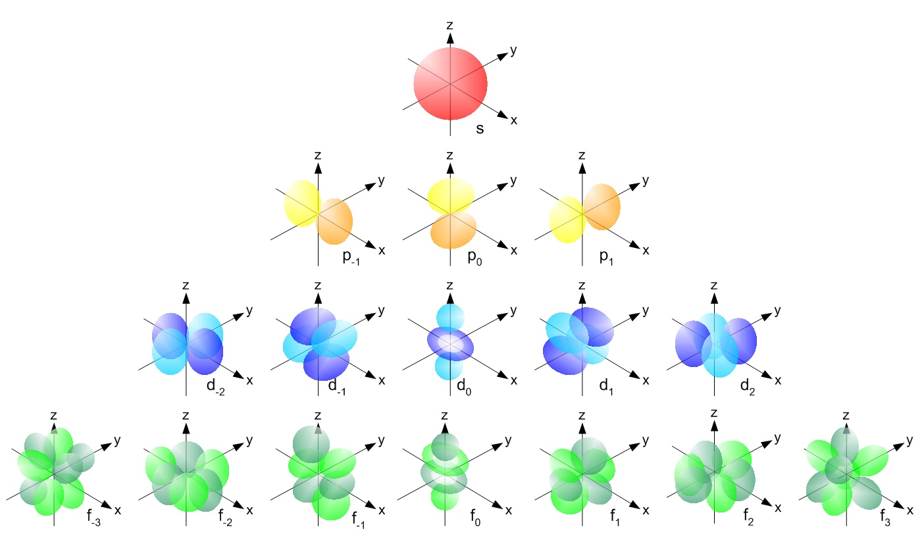
Energy Levels
1
2
3
4
5
6
7
Orbitals

Slide 4
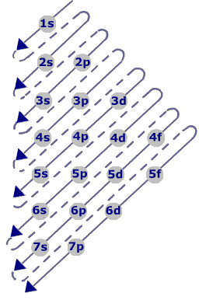
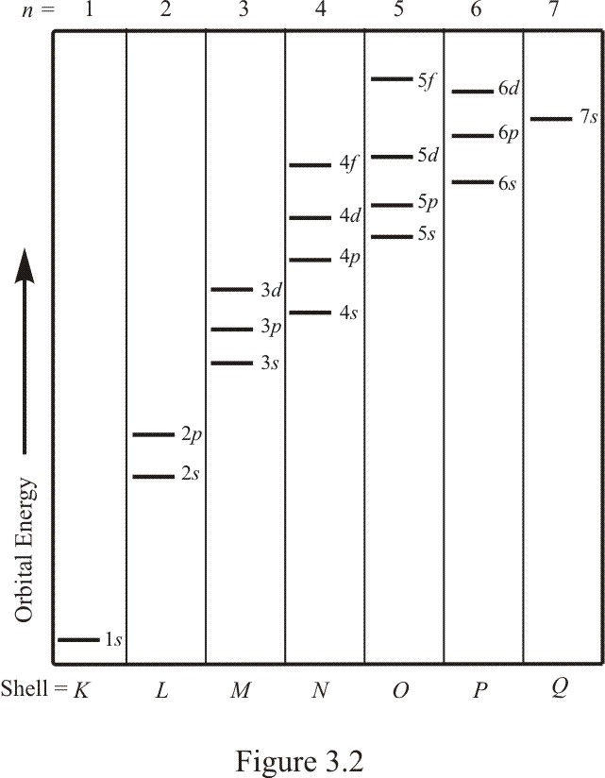
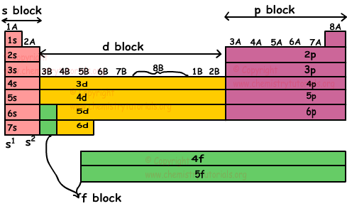
Example: Sodium
1
2
3

