Slide 1
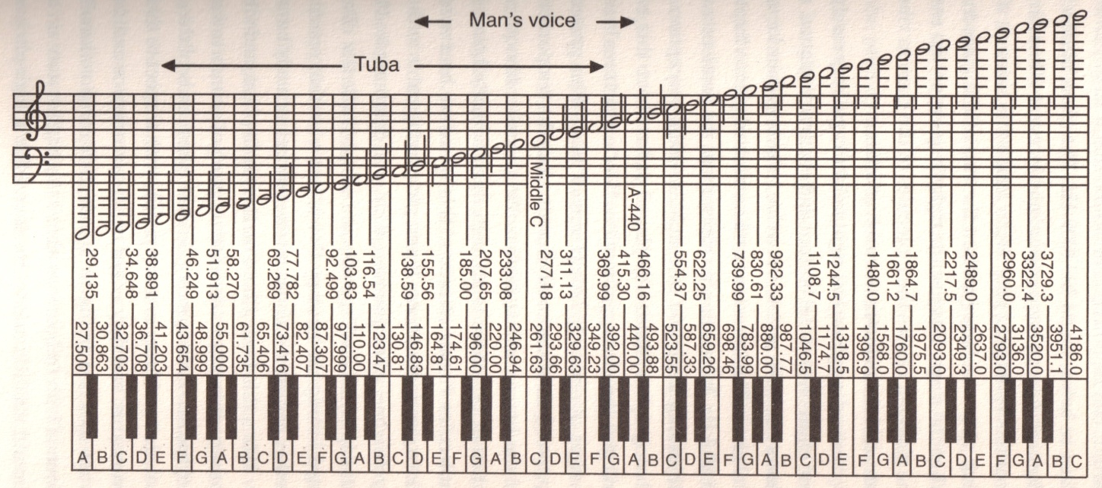
Name _____________________________________ Date ______________________ Period __________
WAVES AND INTERFERENCE
Directions: Use your LabQuest to generate a series of tones and observe what happens when you have higher tones, lower tones, or tones that play at the same time. Answer the questions as you go along.
PART I – PIANO NOTES
1. Generate a tone that simulates middle A on the piano. This note has a frequency of 440 Hz
2. Now simulate moving up one octave on the piano. This means that you are still playing the same note, but it is twice as high as before.
QUESTION 1: What frequency, in hertz, would you need to generate to simulate the A above middle A?
QUESTION 2: How is it possible to generate a tone that is the same note, but is twice as high?
3. Now generate a tone that simulates middle C on the piano. This note has a frequency of 261.626 Hz. Observe that this note is in the same octave, but a little lower than middle A.
QUESTION 3: If you wanted to generate a tone that simulated the A below middle A, what frequency would you need to use?
4. The lowest note on the piano is also an A, but the frequency is 27.5 Hz. Generate a tone with this frequency.

Slide 2
QUESTION 4: What do you notice about this tone that is different than other tones?
5. The highest note on a piano is a C with a frequency of 4186.01. Generate a tone with this frequency.
QUESTION 5: What do you notice about this tone that is different than other tones?
6. It’s often nice to play more than one note at a time. However, certain chords sound better than others. Using your LabQuest, generate a middle C and middle E, at 261.626 Hz and 329.628 Hz, respectively. Play the notes separately, then play them together.
7. Use the piano to play both a C and an E together for the sake of comparason.
QUESTION 7: Does the piano sound the same as the LabQuest? Why or why not?
PART II – INTERFERENCE
8. Pick a frequency on the Lab Quest and record it in the table below.
9. Pick another frequency that is 5 Hz away from your first frequency and record it.
10. Record your observations of what happens when the two frequencies are played at the same time.
QUESTION 8: Why do you think that you observed the “beats” that you did?
11. Move tone two around. Make it closer to tone one and farther away.
QUESTION 9: What happens as you move the tones farther apart or closer together?
QUESTION 10: How can musicians use the concept of these “beats” to help them tune?
Tone 1 | Tone 2 | Observations

