Slide 1
Anatomy and Physiology
Part I

Slide 2
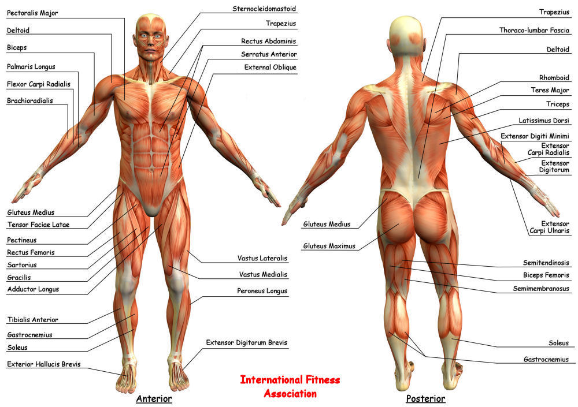
Anatomy – How stuff is set up

Slide 3
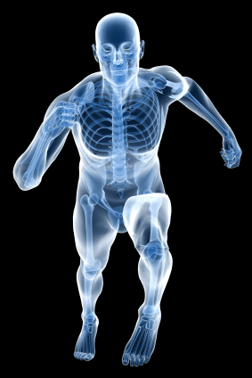
Physiology – How stuff works

Slide 4
Levels of Organization
Organism
Organs
Tissues
Cells
Organelles
atoms

Slide 5
Tissues
Bone
Nerves
Integumentary
Muscle
Cartliage

Slide 6
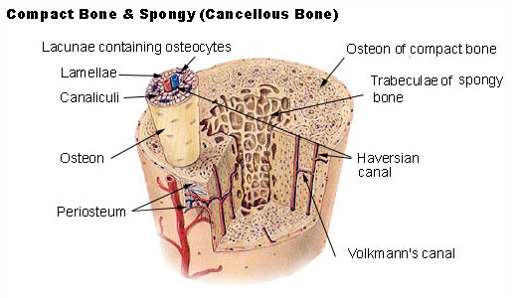
Bone Anatomy
Protein matrix with calcium

Slide 7
Bone feature | Definition
articular process | A projection that contacts an adjacent bone.
articulation | The region where adjacent bones contact each other — a joint.
canal | A long, tunnel-like foramen, usually a passage for notable nerves or blood vessels.
condyle | A large, rounded articular process.
crest | A prominent ridge.
eminence | A relatively small projection or bump.
epicondyle | A projection near to a condyle but not part of the joint.
facet | A small, flattened articular surface.
foramen | An opening through a bone.
fossa | A broad, shallow depressed area.
fovea | A small pit on the head of a bone.
labyrinth | A cavity within a bone.
line | A long, thin projection, often with a rough surface. Also known as a ridge.
meatus | A short canal that finishes as a dead end, so it has only the entrance.
process | A relatively large projection or prominent bump.(gen.)
ramus | An arm-like branch off the body of a bone.
sinus | A cavity within a cranial bone.
spine | A relatively long, thin projection or bump.
suture | Articulation between cranial bones.
tubercle | A projection or bump with a roughened surface, generally smaller than a tuberosity.
tuberosity | A projection or bump with a roughened surface.

Slide 8
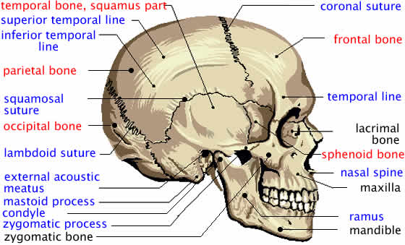

Slide 9
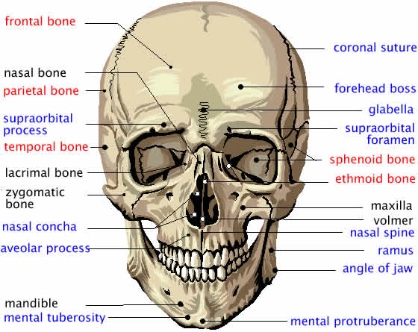

Slide 10
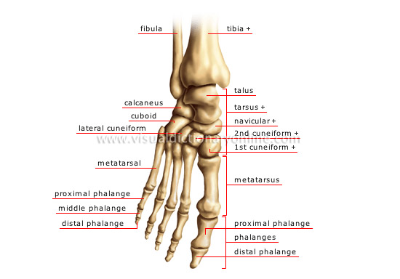

Slide 11
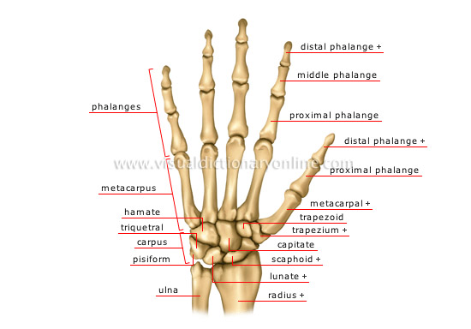

Slide 12
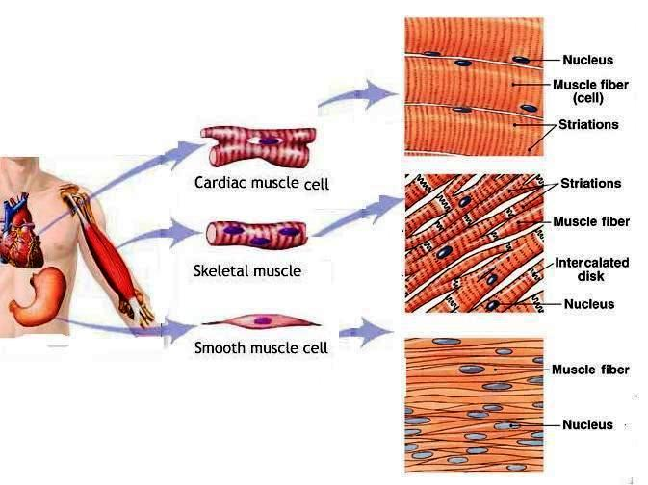
Muscle Anatomy
Cells filled with
contractile proteins

Slide 13
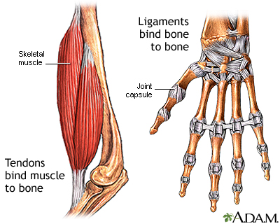

Slide 14
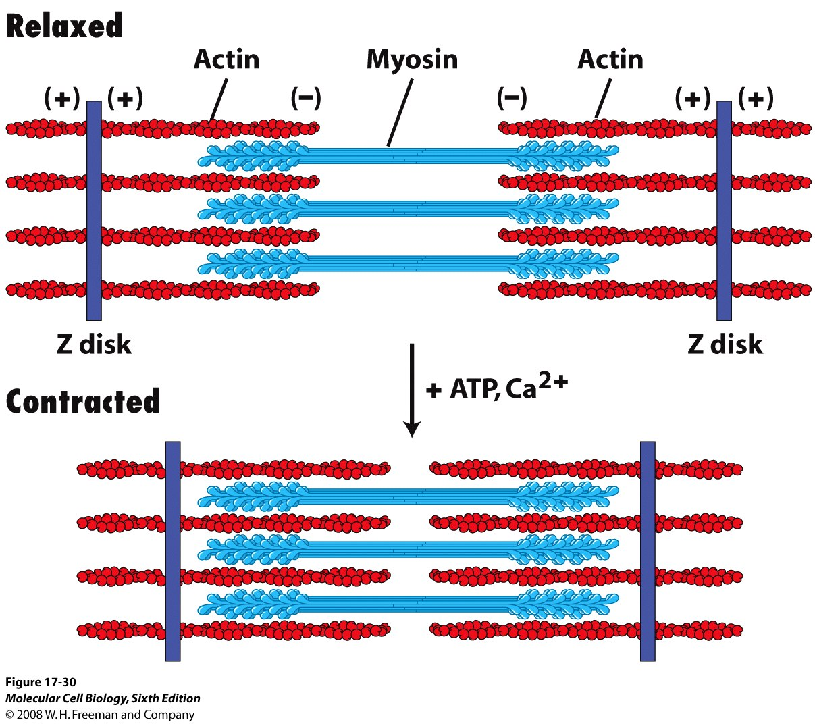

Slide 15
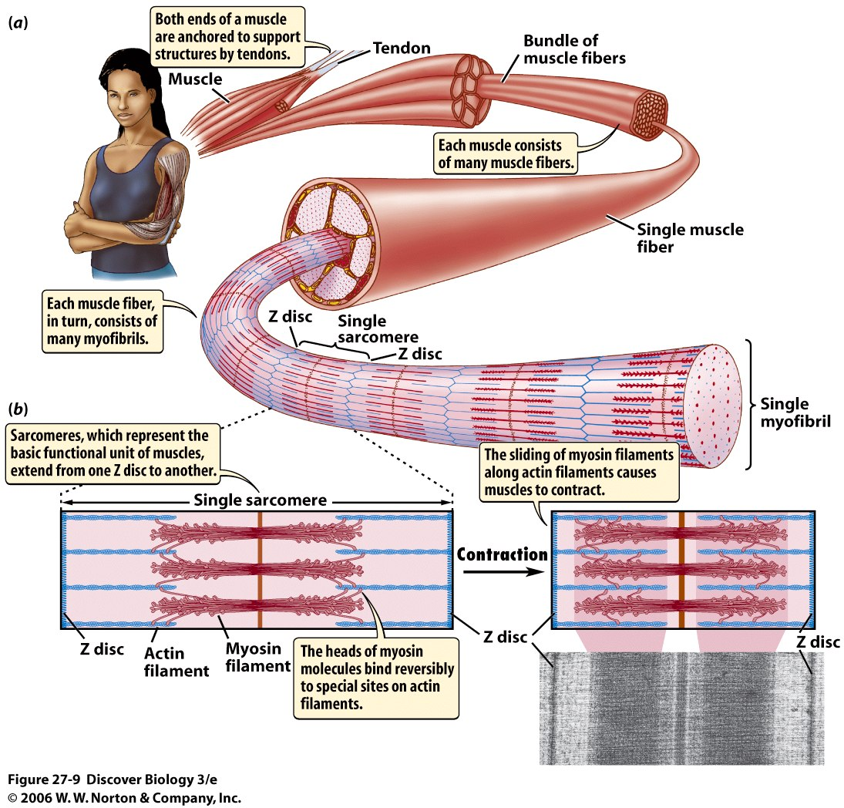

Slide 16
Massage
Demonstrated to reduce stress hormones
Increase blood flow
Helps healing
Helps growth via hormone stimulation

