Slide 1
Sticks, Stones, Bells and Whistles
or
The Seven Truths of Teaching
Mr. David M. Syracuse,
Scientist Extraordinaire

Slide 2
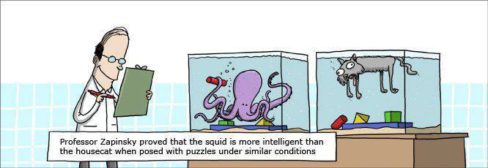
I like to teach kids stuff
in interesting ways.
Why am I here?

Slide 3
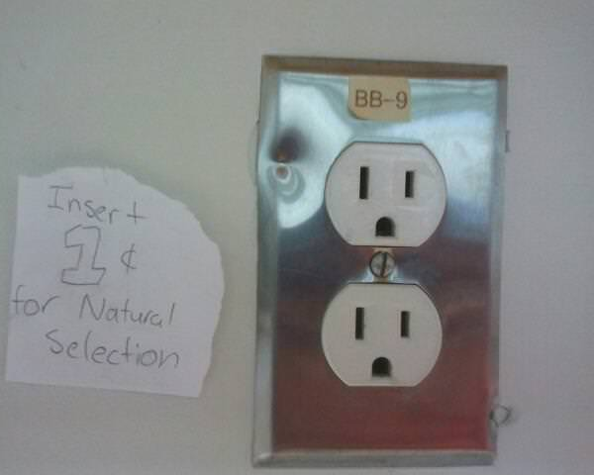
NATURAL SELECTION
Why are you here?
No really…why?

Slide 4
Teaching is a lifestyle
“A good teacher is like a candle – it consumes itself to light the way for others.”
“Teaching teenagers is like trying to nail Jell-O to a tree.”

Slide 5
Truth: You can’t please all of the people all of the time.

Slide 6
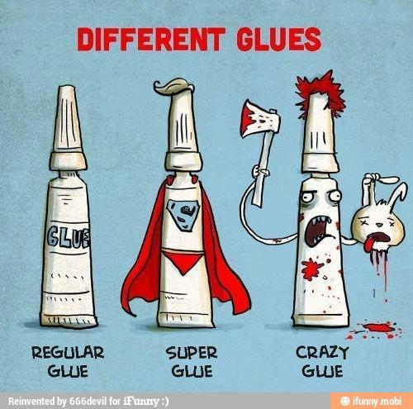
You should probably need a license to have children.

Slide 7
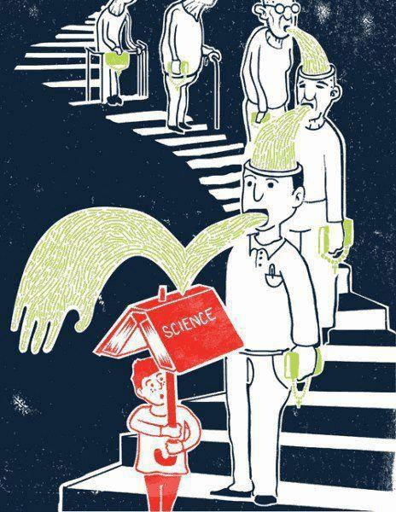
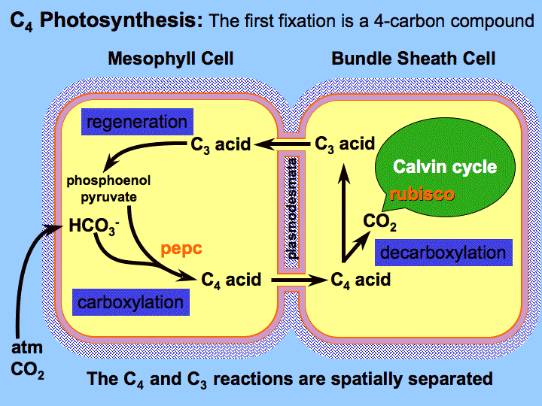
Miss Conception can be a harsh mistress.

Slide 9
Your president
Your senator
Your governor
Your principal
Your representative
Your news anchor
Your mayor
Your police officers
Your mechanic
Your judge
Your oven salesperson

Slide 10
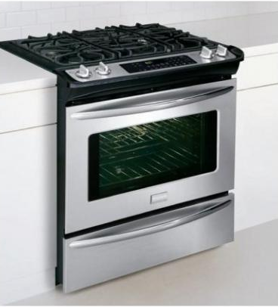

Slide 11
Natural Gas:
CH₄ + 2O₂ → CO₂ + + 891 kJ
2 H₂O
Electric:
e- move not so well → lots-o-heat
AND NO WATER.

Slide 12
Corollary to truth 1:
Truth: You can’t please all of the people all of the time…
…and you shouldn’t try to.

Slide 13
Truth: The only things a teacher really needs are a stick and a rock.

Slide 14
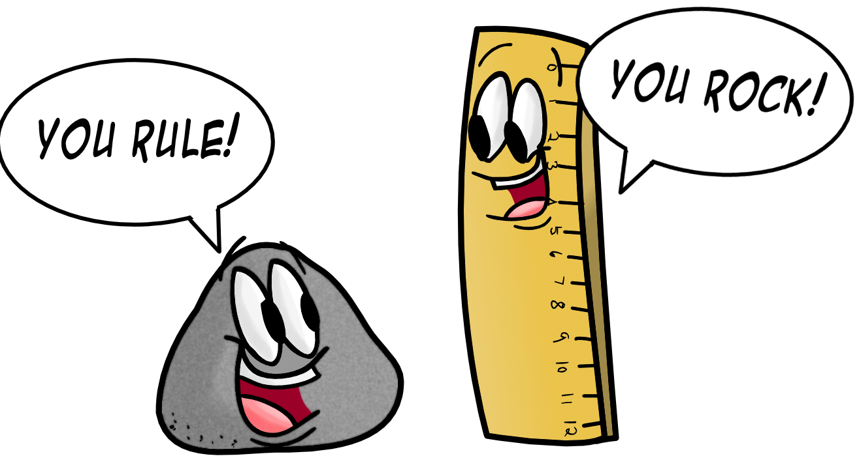
Look! Engaged children!

Slide 15
Truth: Science is no less a story than The Great Gatsby, without that damn green light and all the heat imagery, of course.

Slide 16
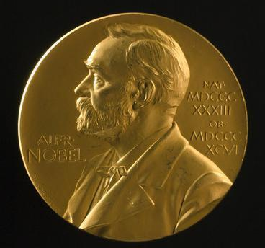
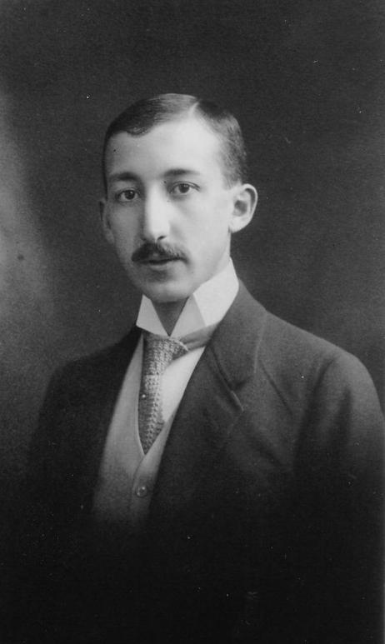
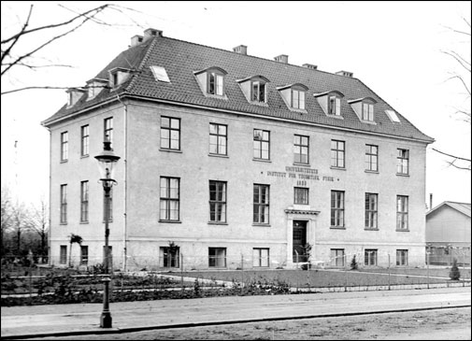
Radioactivity
Georgy de Hevesy

Slide 17
X-ray diffraction
Atomic structure
Max Von Laue
James Franck

Slide 18
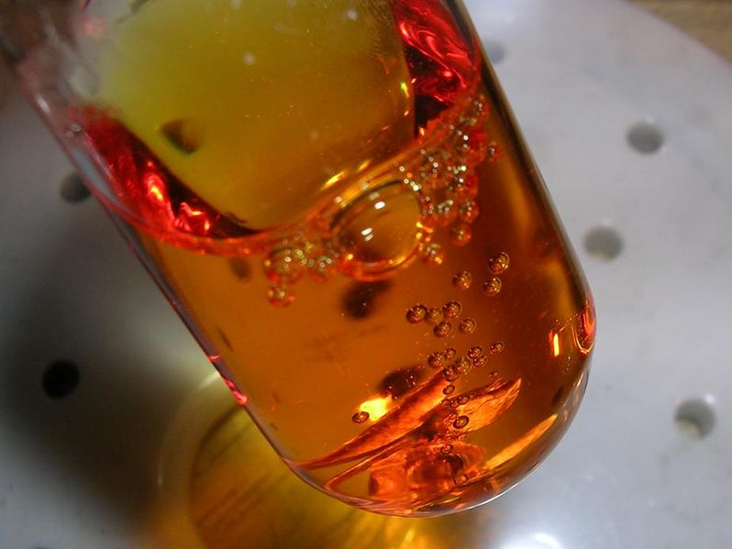
Aqua Regia – HNO3 and HCL

Slide 19
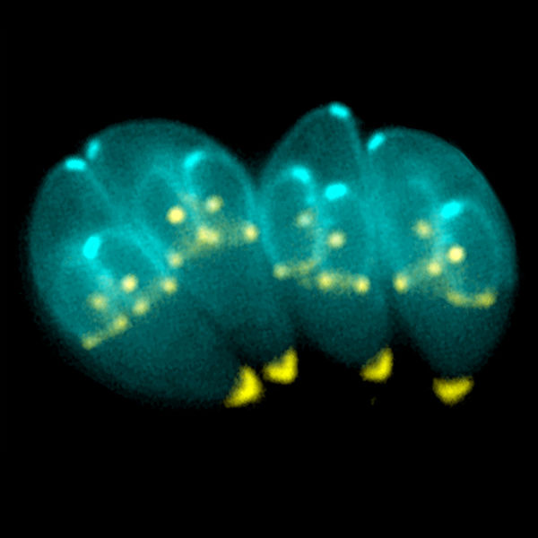
Toxoplasma gondii

Slide 20
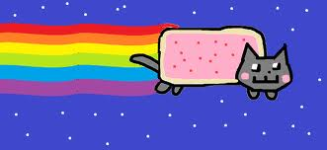
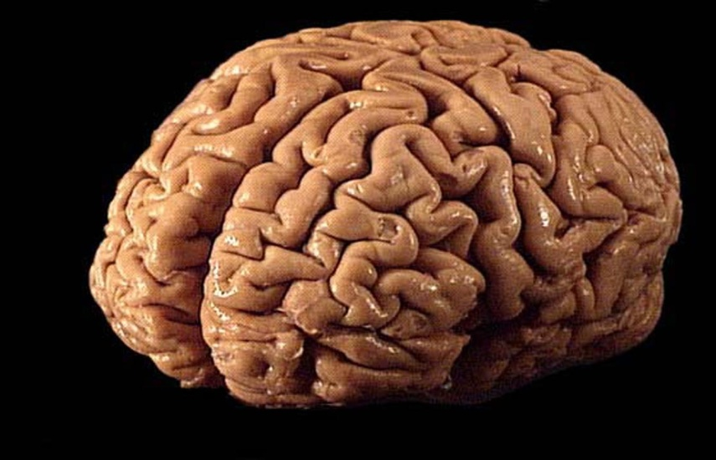
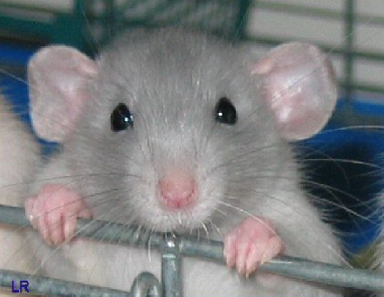
Fear
Pleasure

Slide 22
Truth: Science is its own reward.

Slide 23
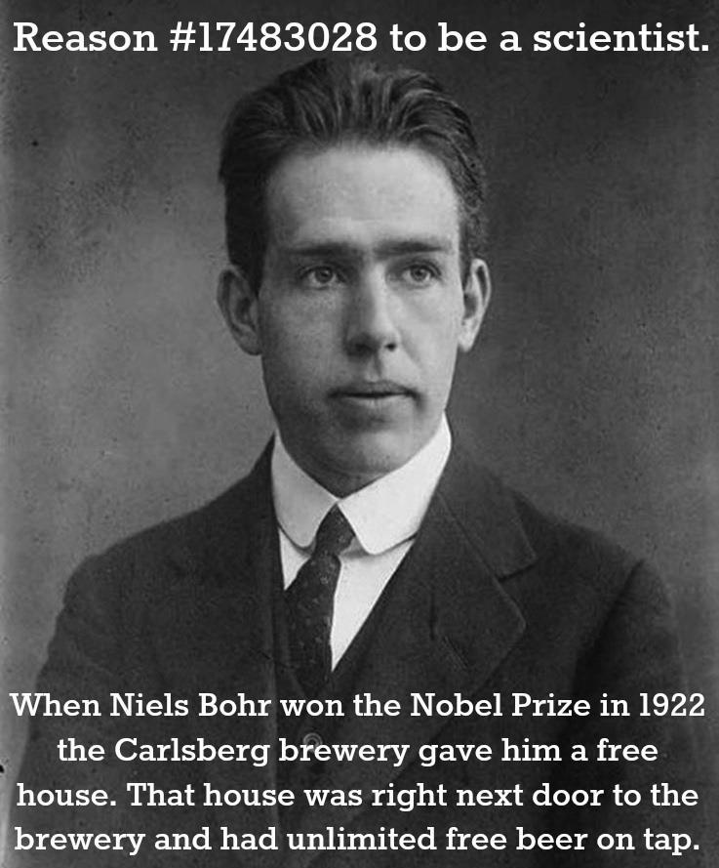
Your students may need motivation.

Slide 24
Truth: Growing old is inevitable, growing up is optional.

Slide 25
Question: What Hardy-Weinberg Rule was broken during this simulation?
Student: “Random Fornification.”
Student: “During what phase of the moon can’t you get pregnant?”
Mr. S: “It doesn’t matter; I lack the appropriate plumbing for that kind of thing.”
[a student is having trouble labeling a diagram of the reproductive system; he has the female diagram, not the male diagram]
Another student, trying to help: “Don’t you ever look down?!”

Slide 26
Truth: As hard as you try, 50% of your students will always be below average.

Slide 28
Truth: Teaching is 70% theater, 25% knowledge and 10% math.

Slide 30
Truth: You have just about 200 hours to change this kid’s life forever.

Slide 31
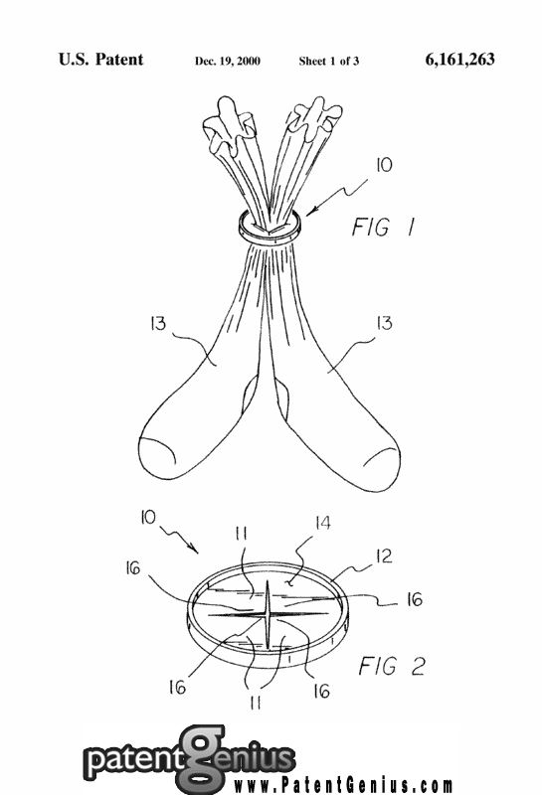
Commence sock retention
Time is an illusion;
lunchtime, doubly so.
– Ford Prefect

Slide 32
180 days of school
45 minutes per day
X
135 hours
45 minutes every other day for lab (67.5 hours)
+
202.5 hours
That’s 8.44 days
Don’t mess up.

Slide 33
What if kids got science in every grade?
That’s 101.28 days of science.
Ever.
0.37% of their lives.

Slide 34
www.mistersyracuse.com
dsyracuse@gmail.com

