Slide 1
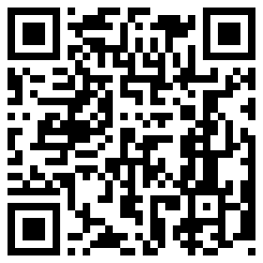
Name __________________________________ Date ____________ Period __________
CHEMISTRY REFERENCE TABLES SCAVENGER HUNT
Directions: Use your shiny new chemistry reference tables (CRT) to find the following information. Don’t be confused by what you’re being asked to find; because it’s early in the year, you may not understand the meaning behind the numbers, but you should, by now, be able to use the charts and graphs in the CRT. Be sure to write your answer, WITH AN APPROPRIATE UNIT, if needed, and which table you used to find it.
ANSWER TABLE
What is standard pressure, in atmospheres?
What is standard temperature, in kelvins?
What unit can be used to measure mass?
Find a unit that can be used to measure concentration.
What is the name of the ion NO₂ -?
Do chlorates form soluble or insoluble compounds?
What is the solubility of hydrochloric acid (HCl) at 50 °C?
What is the vapor pressure of water at 100 °C?
Which metal is more active, Li or Mg?
What is the name of the acid with the formula H₂CO₃?
What is the formula for the base called sodium hydroxide?
What color is the acid-base indicator thymol blue when it is in an acid?
What is the half-life of the radioisotope ⁵³Fe?
What is the nuclear chemistry symbol for a positron?
In organic chemistry, how many carbons does propanol have?
What is the name of the hydrocarbon that has a triple bond in the
structural formula?
What atoms are in the functional group called a ketone?
What is the melting point of titanium?

