Slide 1
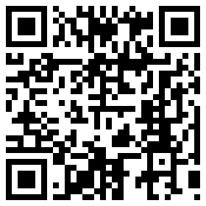
Name _________________________________ Date ______________ Period __________
PREDICTING REACTIONS
Directions: Use your Chemistry Reference Tables and your knowledge of chemistry to do the following for each set of atoms:
Draw each atom in the space provided, including protons, neutrons and electrons. Remember, the first shell can hold 2 electrons, the second can hold 8 and the third can hold 18.
Identify how many more electrons it might want to gain or lose if it had the chance.
Predict if the atoms will react or not by circling your choice next to the element names.
1. Neon and Nitrogen… WILL or WILL NOT React.
2. Sodium and Bromine… WILL or WILL NOT React.
3. Sodium and fluorine… WILL or WILL NOT React.

Slide 2
4. Lithium and Phosphorous… WILL or WILL NOT React.
5. Sulfur and Boron… WILL or WILL NOT React.
6. Beryllium and Magnesium… WILL or WILL NOT React.

