Slide 1
Chemistry
Part III:
See you later;
I’m goin’ fission

Slide 2
So far: Chemical reactions
Reduction is Gaining e-
Oxidation is Losing e-
4Fe + 3O₂ → 2Fe₂O₃
Oxygen gained 2 e-
Iron lost 3 e-

Slide 3
Deal only with electrons
We call Fe₂O₃ iron (III) oxide
Iron can lose 2 or 3 e-
FeO is iron (II) oxide
Iron lost
Oxygen gained
2 e-
2 e-

Slide 4
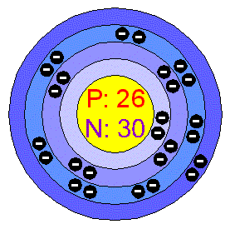
Electrons are (relatively) easy to pluck away from an atom. This is the Ionization energy

Slide 5
The nucleus has all positive charges…why doesn’t it blow apart?
P
P
P
P

Slide 6
The nucleus is held together much more tightly.
P
P

Slide 7
And it is TINY.
Measure it in femptometers
1 fm = 0.000000000000001 m
Or 1.0 x10^{-15 m}
Or 1 quadrillionth of a meter

Slide 8
The Strong Nuclear force
An exchange force – pions are exchanged between protons.
P
P
π

Slide 9
The Strong Nuclear force
Attractive at 1 fm
No action > 2.5 f
Repulsive < 0.7 fm
P
P
0.7 fm
2.5 fm

Slide 10
Ionization Energy
Uranium – 584,000 J/mol
Nuclear reaction
Uranium –
3.20435292 × 10⁻¹¹ joules per atom

Slide 11
But…
1 mole is 6.02 x 10²³ atoms of uranium.
So…
That’s 1.928 x 10¹³ J/mol

Slide 12
1 g of uranium = 1 MW of electricity
That’s as much as 3 tons of coal or 600 gallons of oil.
1 mol uranium = 238 g
That’s 238 MW per mole!

Slide 13
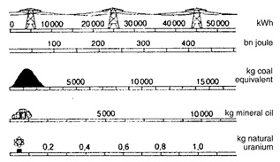

Slide 14
Isotopes – different number of neutrons
CHANGING THE NUMBER OF PROTONS CHANGES THE ELEMENT! -- “Transmutation”
¹⁴C – “carbon 14”
²³⁵U – “uranium 235”

Slide 15
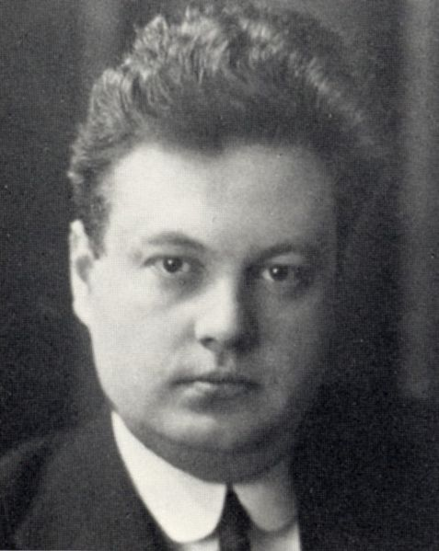
Radiation Units
Sievert (Sv): Dose Equivalent Radiation
Named after
Rolf Maximilian
Sievert

Slide 16
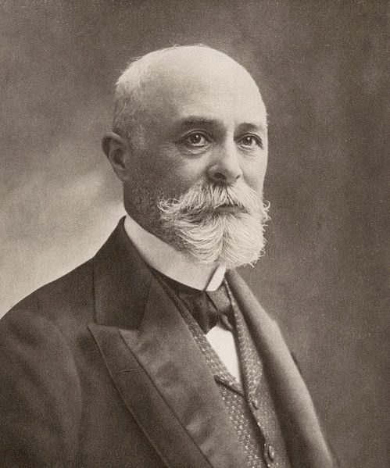
Radiation Units
Becquerel (Bq): One nucleus decays per second
Named after
Antoine
Henri
Becquerel

Slide 17
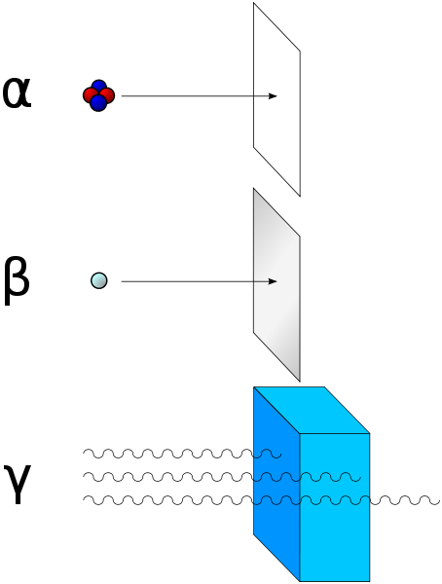
Nuclear decay
Alpha Particle
Beta Particle
Gamma Particle

Slide 18
Alpha Particle = 2 neutrons and 2 protons.
Like a helium nucleus!
Atomic Mass
4
He
2
Atomic Number

Slide 19
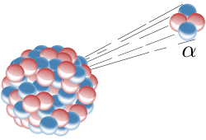
Easily stopped by paper or dead skin.
Radon is a source of alpha particles.

Slide 20
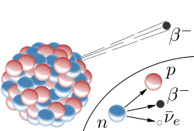
Beta particle = one electron.
Neutrons are converted into protons, resulting in an electron being released.

Slide 21
Easily stopped by aluminum foil.
Come from decay of common radioactive elements.
0
e-
-1

Slide 22
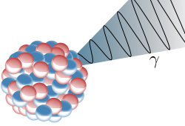
Gamma particle = a high-energy photon.
0
γ
0
Come from decay of common radioactive elements.

Slide 23
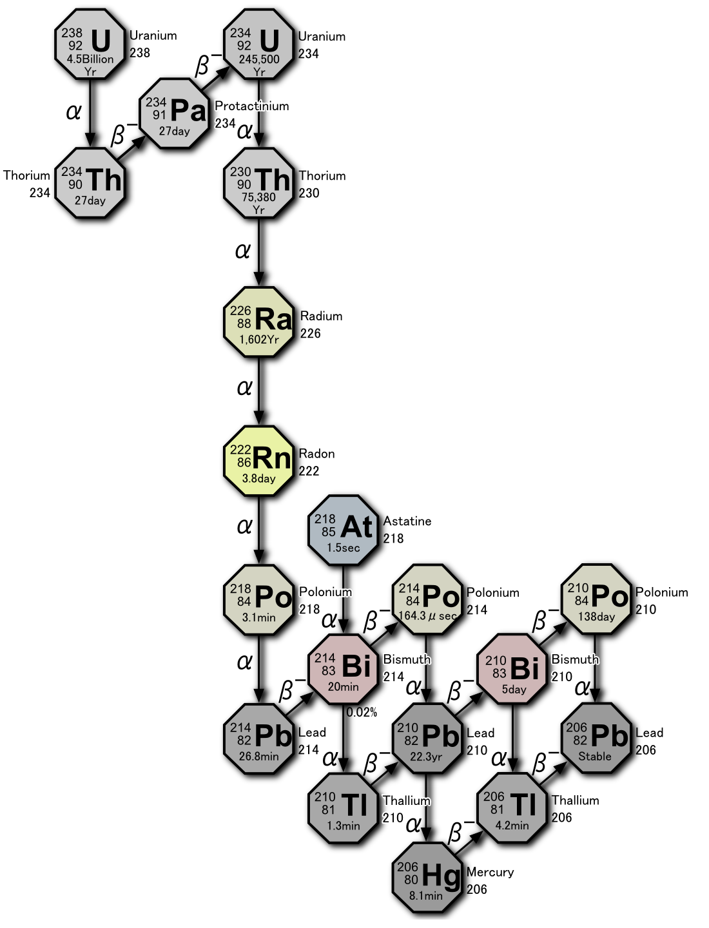
Decay doesn’t happen all at once.
Decay Series
For uranium

Slide 24
Half life: The amount of time it takes for half of a sample to decay
Number of half-lives elapsed | Fraction remaining | Percentage remaining
0 | ¹/₁ | 100
1 | ¹/₂ | 50
2 | ¹/₄ | 25
3 | ¹/₈ | 12 | .5
4 | ¹/₁₆ | 6 | .25
5 | ¹/₃₂ | 3 | .125
6 | ¹/₆₄ | 1 | .563
7 | ¹/₁₂₈ | 0 | .781
... | ... | ...
n | 1/(2^{n}) | 100/(2^{n})

Slide 25
Examples:
Uranium-lead
Samarium-neodymium
Potassium-argon
Rubidium-strontium
Uranium-thorium

Slide 26
Example:
If the half-life of uranium is 4.5 billion years, how long would it take for 2 g to decay to .5 g?

Slide 27
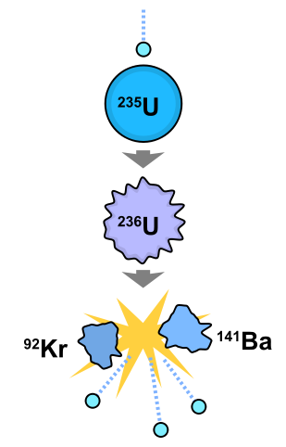
Fission – One nucleus splits apart when a neutron makes it unstable

Slide 28
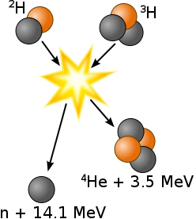
Fusion – Two nuclei combine, become unstable and release energy

Slide 29
Nuclear bombs
Measured in kilotons or megatons
The equivalent amount of TNT

Slide 30
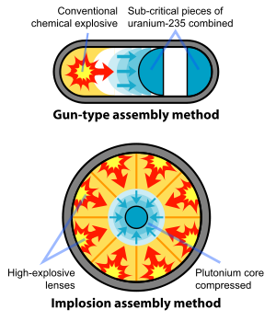
Fission
Method
“Atomic
bomb”

Slide 31
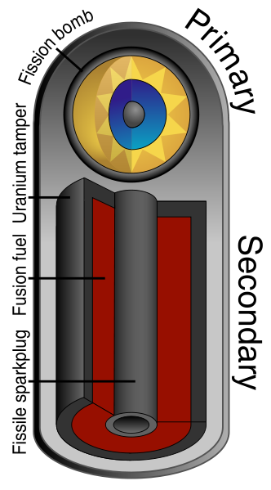
Fusion Method
“Hydrogen
bomb”

Slide 32

Mushroom Cloud

Slide 33
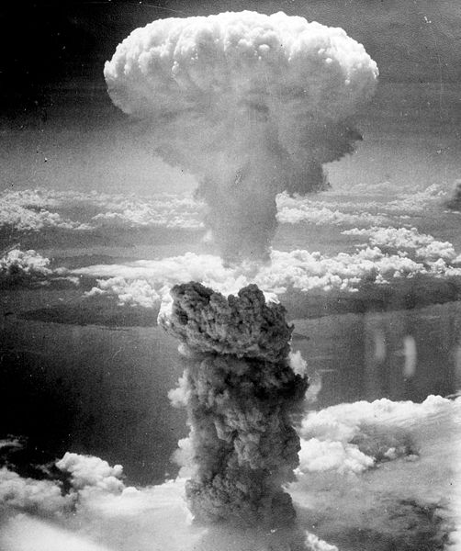

Slide 34
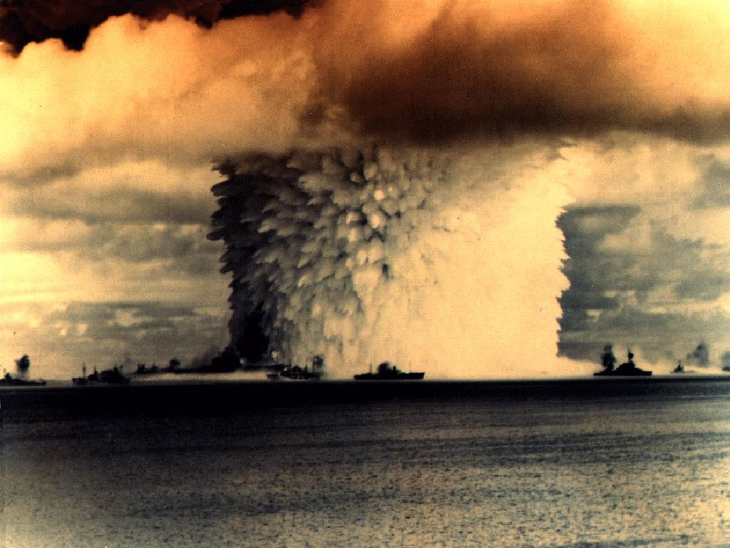

Slide 35
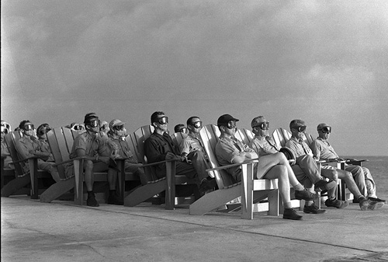
Operation Greenhouse, Enewetak Atoll, 1951

Slide 36
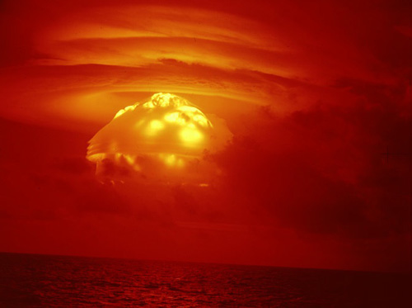
Castle Bravo detonation, March 1, 1954. 15 megatons. Largest nuclear test conducted by the United States.

Slide 37
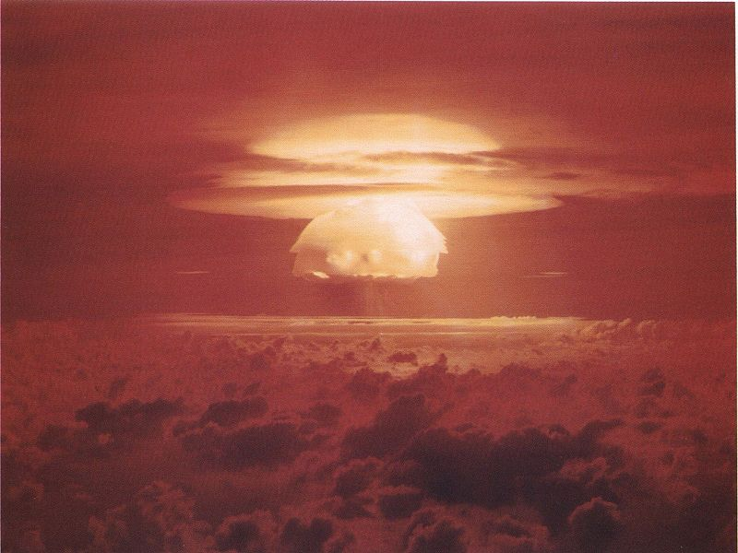
Castle Bravo detonation, March 1, 1954. 15 megatons. Largest nuclear test conducted by the United States.

Slide 38
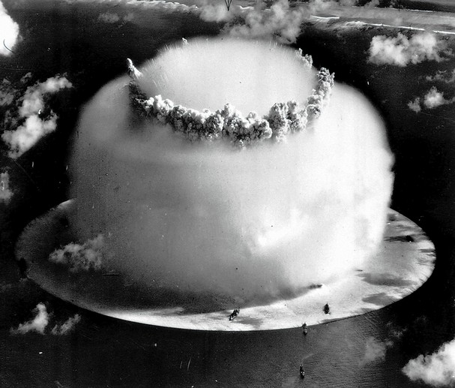
Bikini Atoll on July 25, 1946

Slide 39
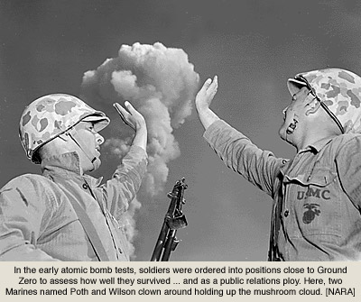

Slide 40
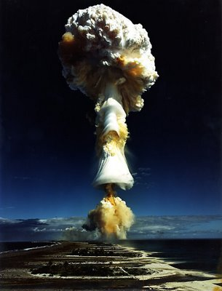

Slide 41
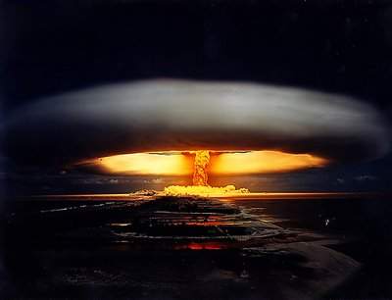

Slide 42
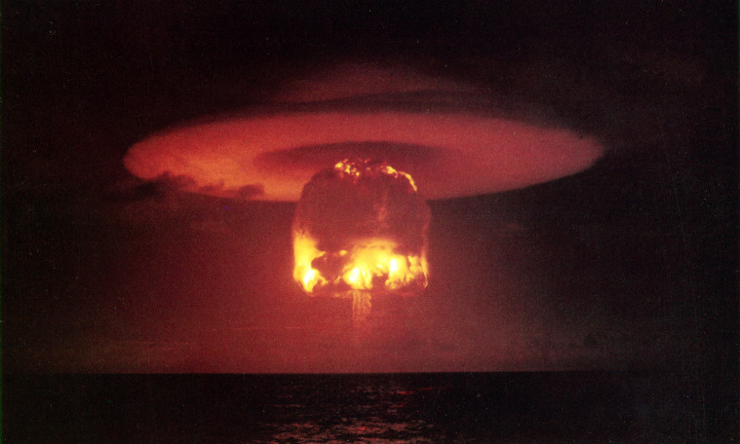
11Mt, Bikini Atoll

Slide 43
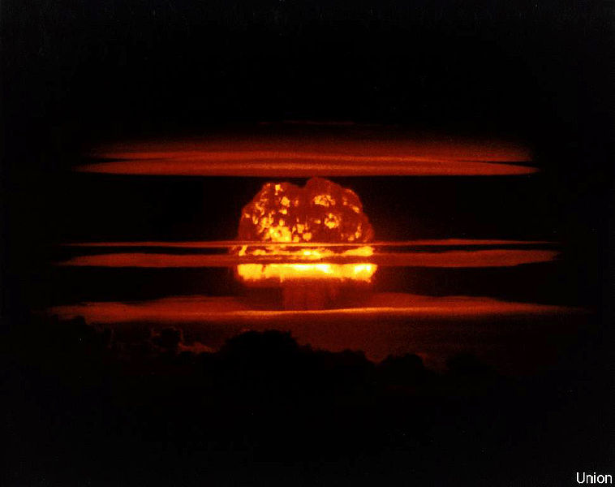
6.9Mt, Bikini Atoll

Slide 44
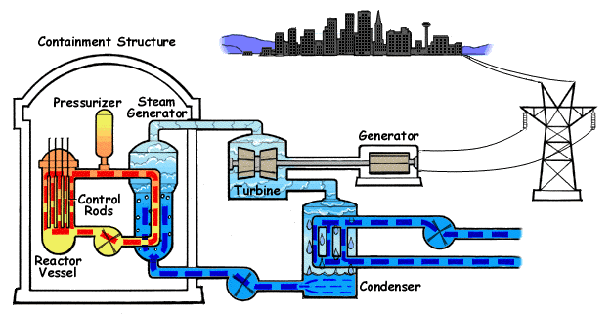
Nuclear Reactors

Slide 45
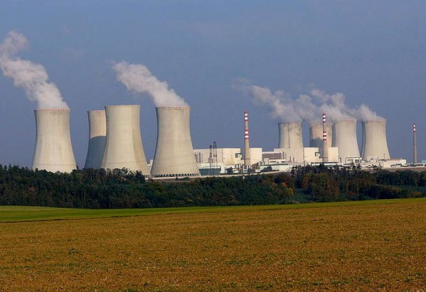

Slide 46
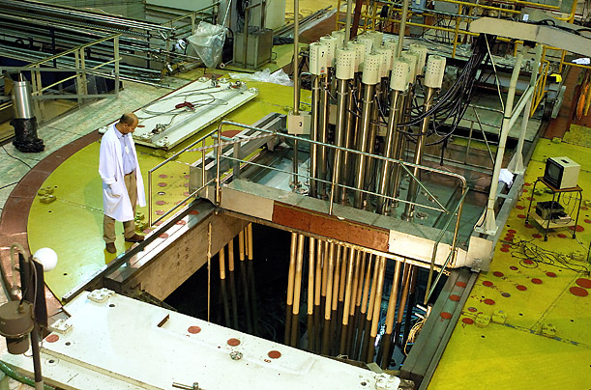

Slide 47

Airline Crew
Exposed at about 6 µSv/hr
Limit is 1 mSv/year

Slide 48
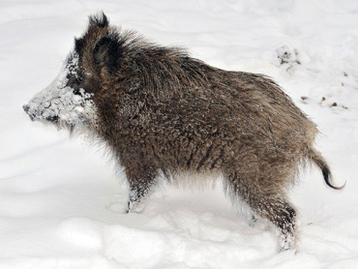
Radioactive German Wild Boar?

Slide 49
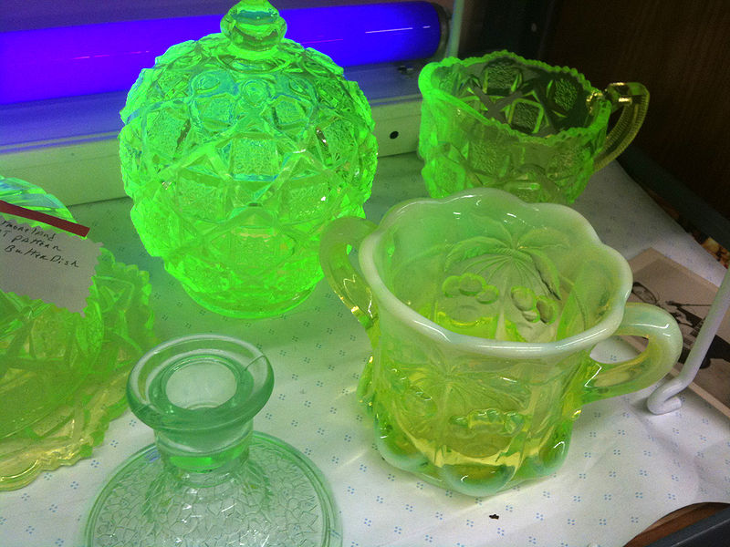
1930s uranium glassware

Slide 50
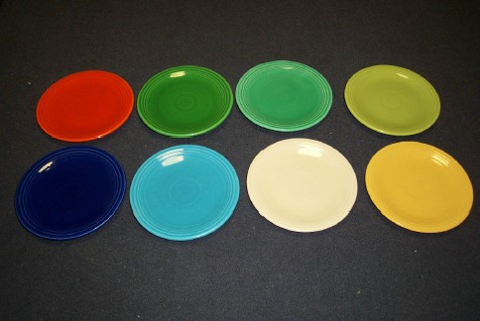
Fiestaware with uranium glaze

