Slide 1
Chemistry
Part II:
Moley-moley-
moley

Slide 2
A mole is
6.02 x 10²³ things
602,000,000,000,000,000,000,000
That’s 602 hexillion!

Slide 3

10,000 dots
60,200,000,000,000,000,000
more pages to make one mole

Slide 4
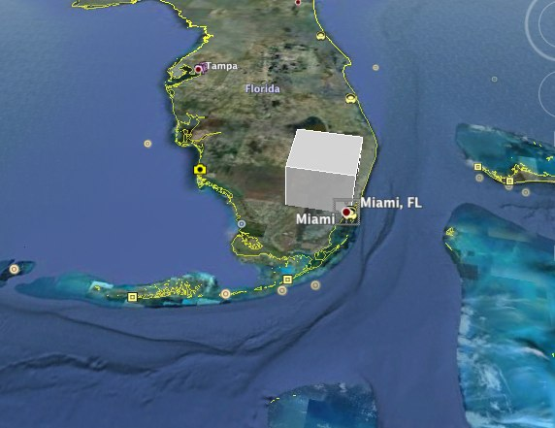
A mole of salt grains

Slide 5
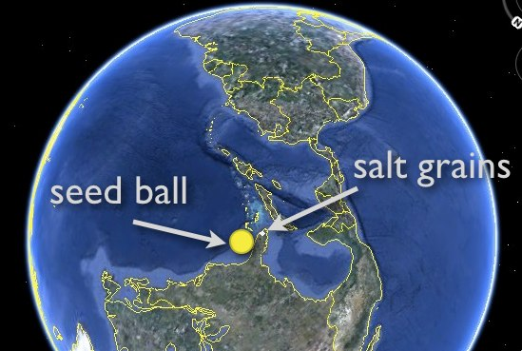
A mole of popcorn seeds

Slide 6
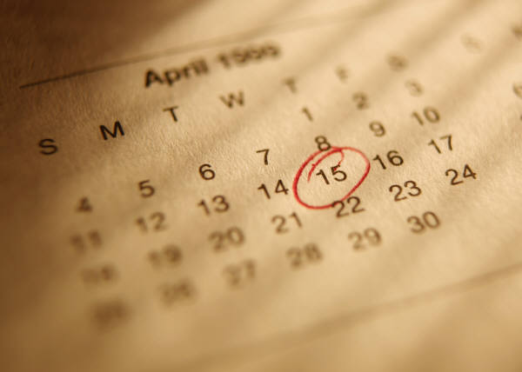
One mole of seconds is
19,089,294,774,226,280 years
19 quadrillion…
(longer than the
universe has been around...)

Slide 7

One mole of marbles
Would make a mountain 116 times taller than Mt. Everest and with a base the size of the USA.

Slide 8
That’s 1,026,368 m tall.
Which is about the
distance from Ithaca
to Atlanta

Slide 9
The mass of one mole
of rice
Is equal to the mass of
5 quadrillion cars

Slide 10
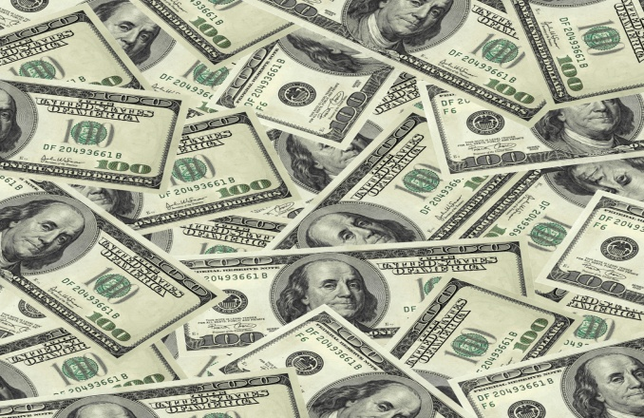
If you spent one billion dollars a second,
It would take you over 19 million years to spend a mole of dollars!

Slide 11
One mole of paper stacked up
would reach to the moon and back
80 million times!

Slide 12

One mole of textbooks would cover the entire US to a depth of 320 km.

Slide 13
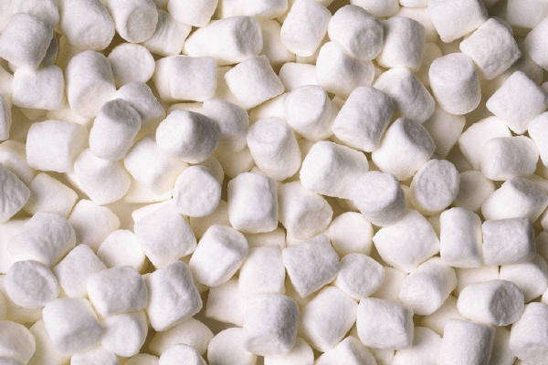
One mole of marshmallows would cover the US to a depth of 105,000 km.

Slide 14
If we had a mole of pennies and gave it out to everyone on earth, they could all spend one million dollars an hour and still have half of it left over when they die.

Slide 15
One Guacomole would require a train that would stretch to the north star and back 2.5 times to transport it. That’s 680 light years.

Slide 16
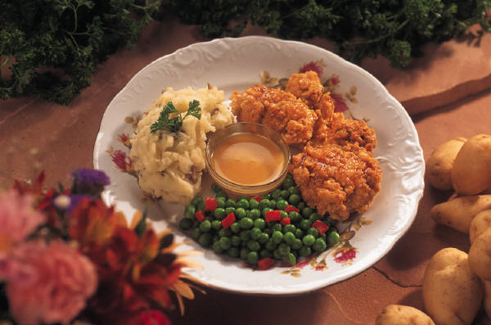
One mole of peas is enough to cover Earth and 250 more planets the same size as Earth one meter deep in green peas

Slide 17
One mole of moles placed head to tail would stretch for 11 million light years, and weigh almost as much as the moon.

Slide 18

A stack of one mole of pennies is tall enough to reach Proxima Centauri (the second closest star to Earth) and back again 7448 times

Slide 19
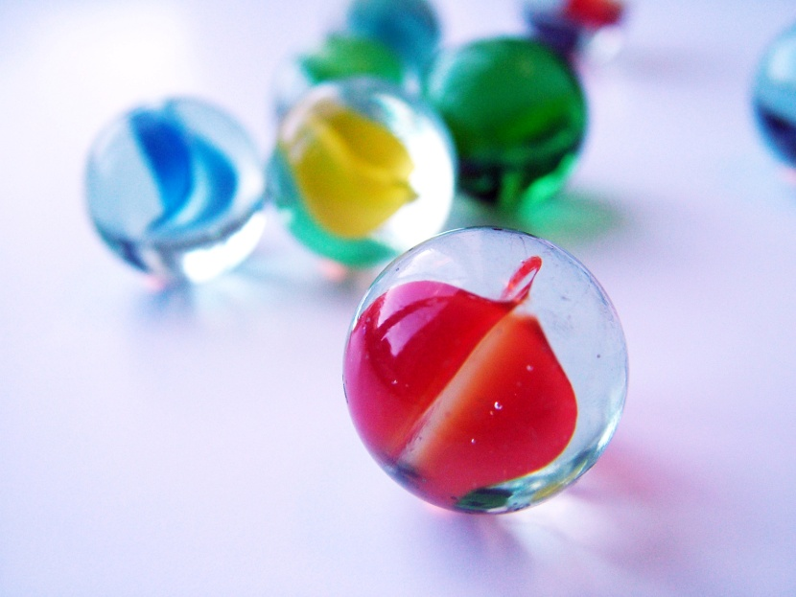
A mole of marbles spread over the Earth would cover it to a depth of 80 km

Slide 20
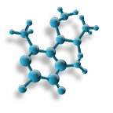
October 23rd is Mole Day!
Click this, Syracuse!

Slide 21
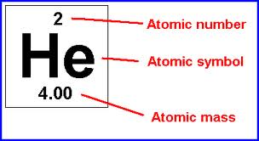
Atomic Mass = number of protons plus number of neutrons
Atomic Mass = number of grams in one mole

Slide 22
Example:
Water
Nitrogen
Ammonia
Gold
Uranium
Sodium hydroxide
Mass of one mole
18 g
28 g
17 g
107 g
238 g
40 g

Slide 23
Molarity
Example:
A one molar solution of NaCl has one mole of NaCl for every one liter of water.

Slide 24
How many grams of NaCl does it take to make 1 L of a 1 M solution?

Slide 25
How many grams of NaOH are needed to make 3 L of a 1.5 M solution?

Slide 26
What is the molarity of 5 L of solution with 50 g of KOH dissolved in it?

Slide 27
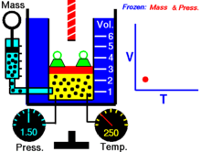
A mole of gas is tricky…

Slide 28
Measure at STP
Standard Temperature and Pressure
0 °C and 1 atmosphere

Slide 29
1 mol of an ideal gas = 22.4 L at STP

Slide 30
How many moles of an ideal gas are there are in 60 L?

Slide 31
How many moles of an ideal gas would it take to fill 100 pop bottles?

Slide 32
How much space would 700 moles of an ideal gas take up?

Slide 33
Reactions!
H₂ + O₂ → H₂O
2
2
2
The coefficients = the number of moles required!

Slide 34
What goes in…
Every atom needs to be accounted for. If it enters the reaction, it must exit somehow. Matter must not disappear!

Slide 35
Example:
Fe + Cl₂ → FeCl₃
2
3
2
Zn + HCl → ZnCl₂ + H₂
1
2
1
1
1
1
Cu + AgNO₃ → Cu(NO₃)₂ + Ag
2
2

Slide 36
1
1
Cu + AgNO₃ → Cu(NO₃)₂ + Ag
2
2
So how many grams of copper and silver nitrate would you need to complete this reaction?
How many grams silver do you get out?

