Slide 1

Chemistry
Part I:
No yelling at
the table

Slide 2
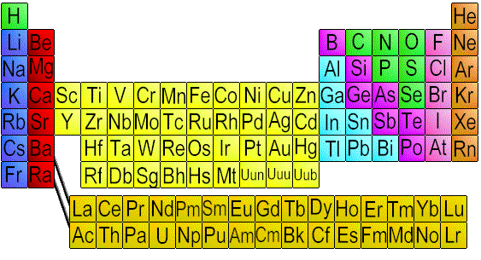
Le Table
Noble gasses
non-metals
“other” metals
Alkali metals
Semi-metals
Inner transition metals
Halogens
Alkaline earth metals
Transition metals

Slide 3
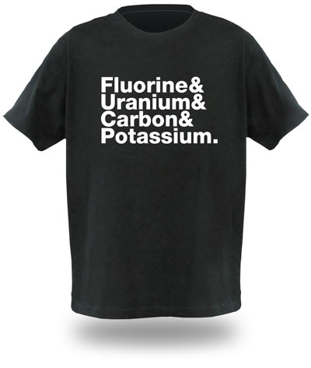

Slide 4
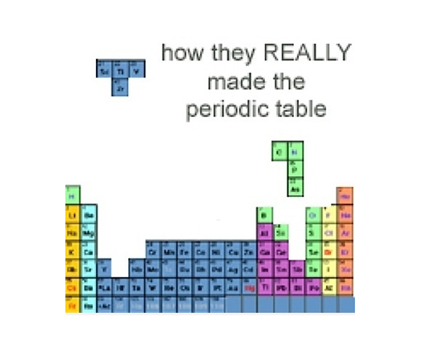

Slide 5
Block Guide
Atomic Number
119
Oxidation State
+1
+2
Symbol
Sy
Name
Atomic Mass
Syracusium
Electron
Configuration
310
2-8-18-32-32-18-8-1

Slide 6
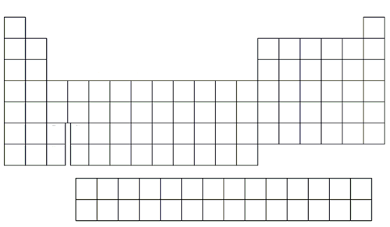
Ionization Energy

Slide 7

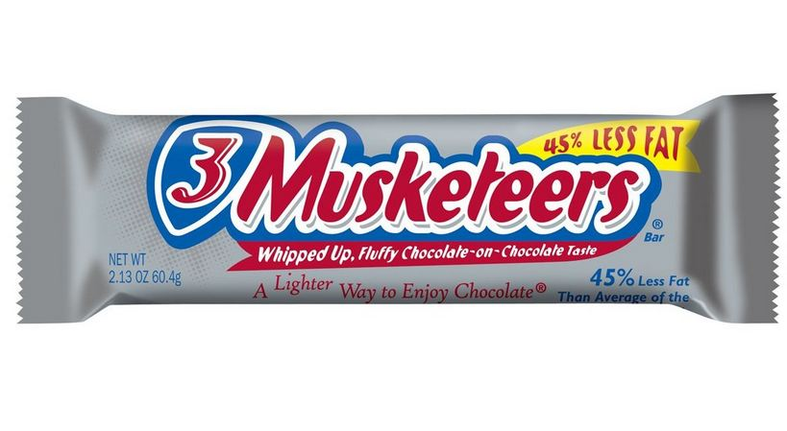
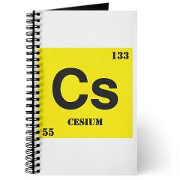
Ionization Energy
Highest
2372 kJ/mol
Lowest
376 kJ/mol

Slide 8
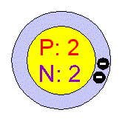
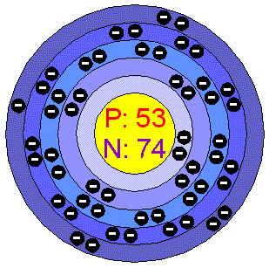
Ionization Energy
Valence e- close
to nucleus
Valence e- far
from nucleus;
e- shielding

Slide 9
Atomic Radius

Slide 10
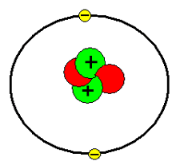
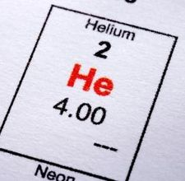
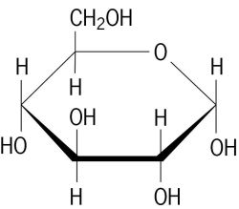
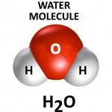
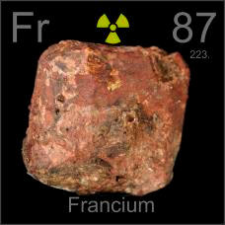
Atomic Radius
Smallest
31 pm
Largest
242 pm

Slide 11
Electronegativity

Slide 12
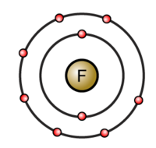

Slide 13
Metallic Character

Slide 14
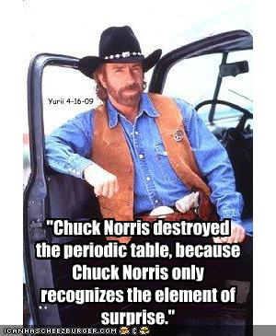

Slide 15
Energy Levels
1
2
3
4
5
6
7
S
S
p
p
s – 2 electrons
p – 6 electrons
d – 10 electrons
f – 14 electrons
S
d
S
p
d
f
S
p
d
f
S
p
d
S
p

Slide 16
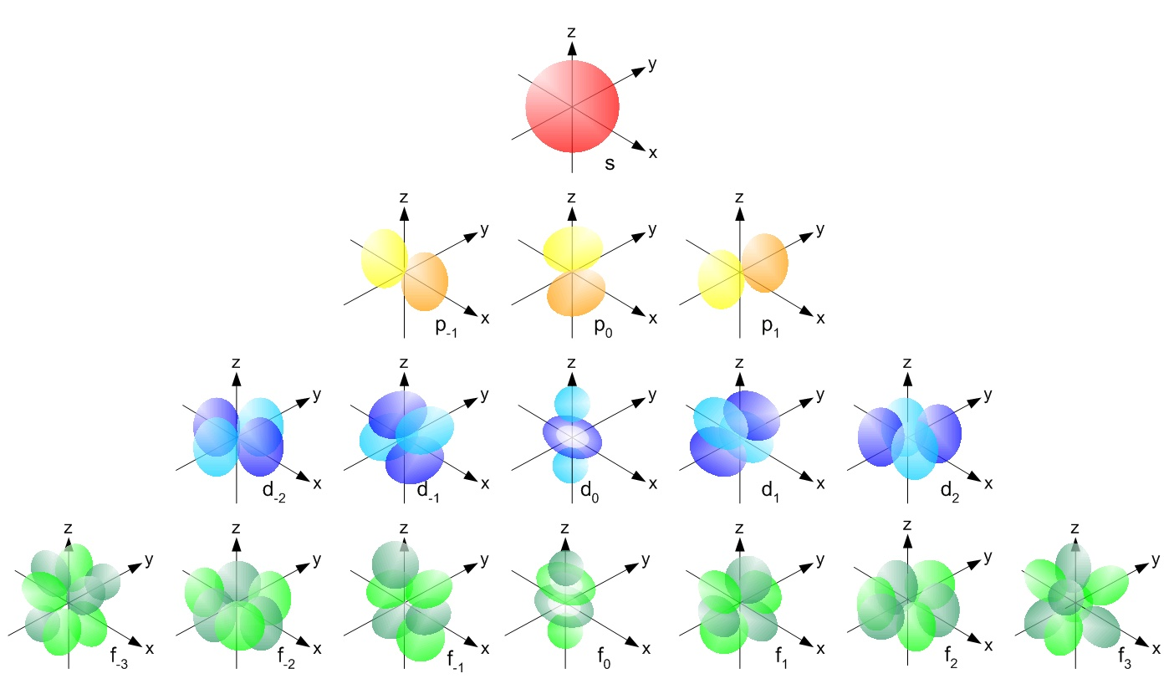
Orbital Shapes

Slide 17
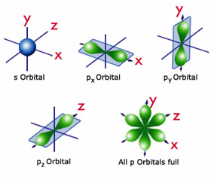
S- and d- Orbitals

Slide 18
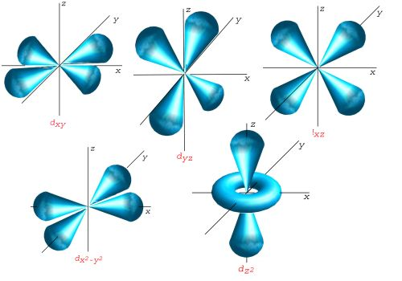
d orbitals

Slide 19
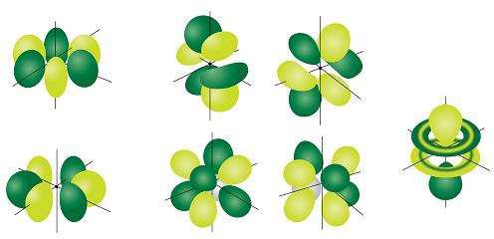
f orbitals

Slide 20
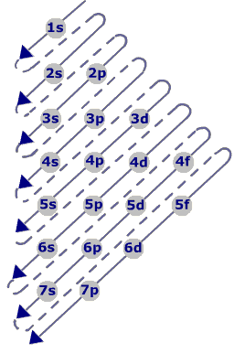
Filling Orbitals
Example:
Sodium
1
2
3

Slide 21
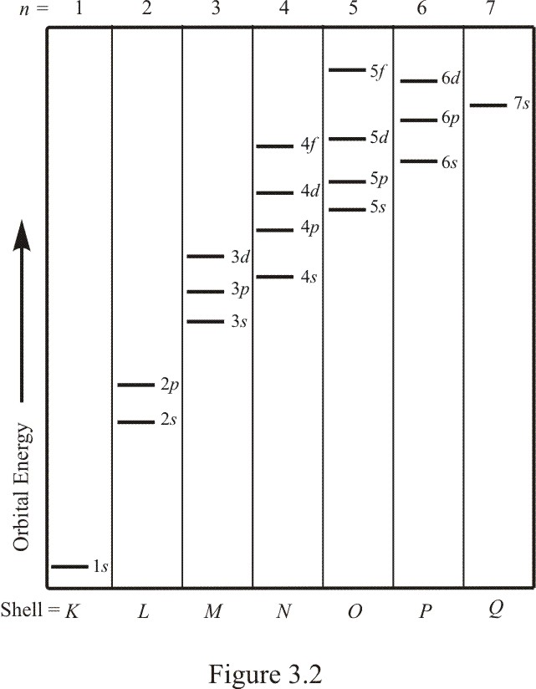
Orbital Energies

Slide 22
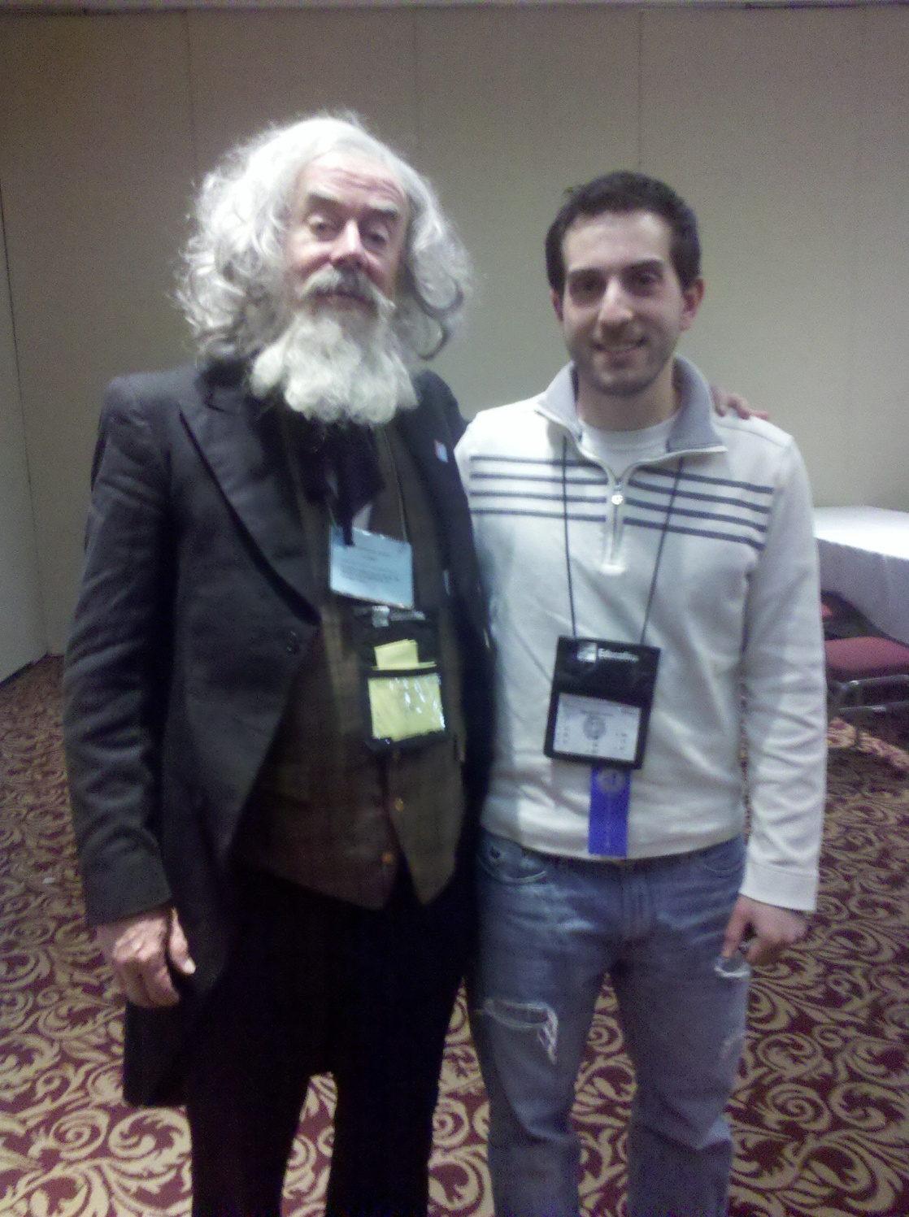

Slide 23
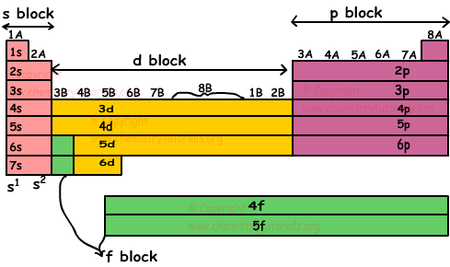
More Patterns!

