Slide 1
Name ___________________________________________ Date ________________ Period __________
Part III: See you later; I’m goin’ fission
Chemical Reactions only deal with __________________.
Reduction is _________________, Oxidation is _____________.
Nuclear reactions deal with the _________________.
4Fe + 3O₂ → 2Fe₂O₃
The product is called ________________________.
FeO is called __________________, because iron lost _______
Electrons and oxygen gained _____________ electrons.
Plucking away electrons requires ________________________.
We can measure the nucleus in __________________________,
or quadrillionths of a meter.
1 fm = 0.000000000000001 m

Slide 2
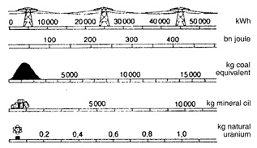
The Strong Nuclear force
An exchange force – pions are exchanged between protons.
P
P
P
Attractive at _____ fm
No action > _____ f
Repulsive < _____ fm
Limits atomic size!

Slide 3
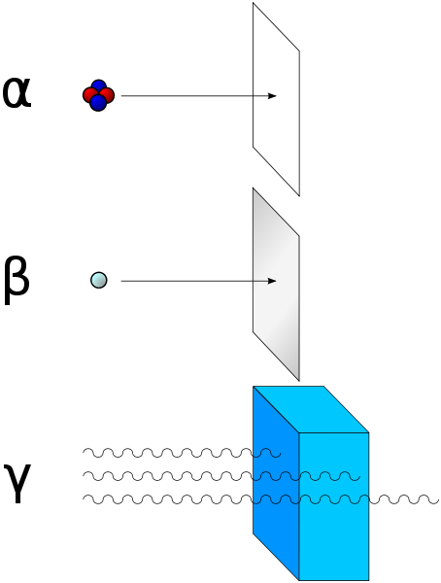
Isotopes – different number of neutrons
CHANGING THE NUMBER OF PROTONS CHANGES THE ELEMENT! -- “Transmutation”
Radiation Units:
Sievert:
Becquerel:
¹⁴C – “carbon 14”
²³⁵U – “uranium 235”
Nuclear decay
4
Alpha Particle
He
2
0
Beta Particle
e-
-1
0
γ
Gamma Particle
0

Slide 4
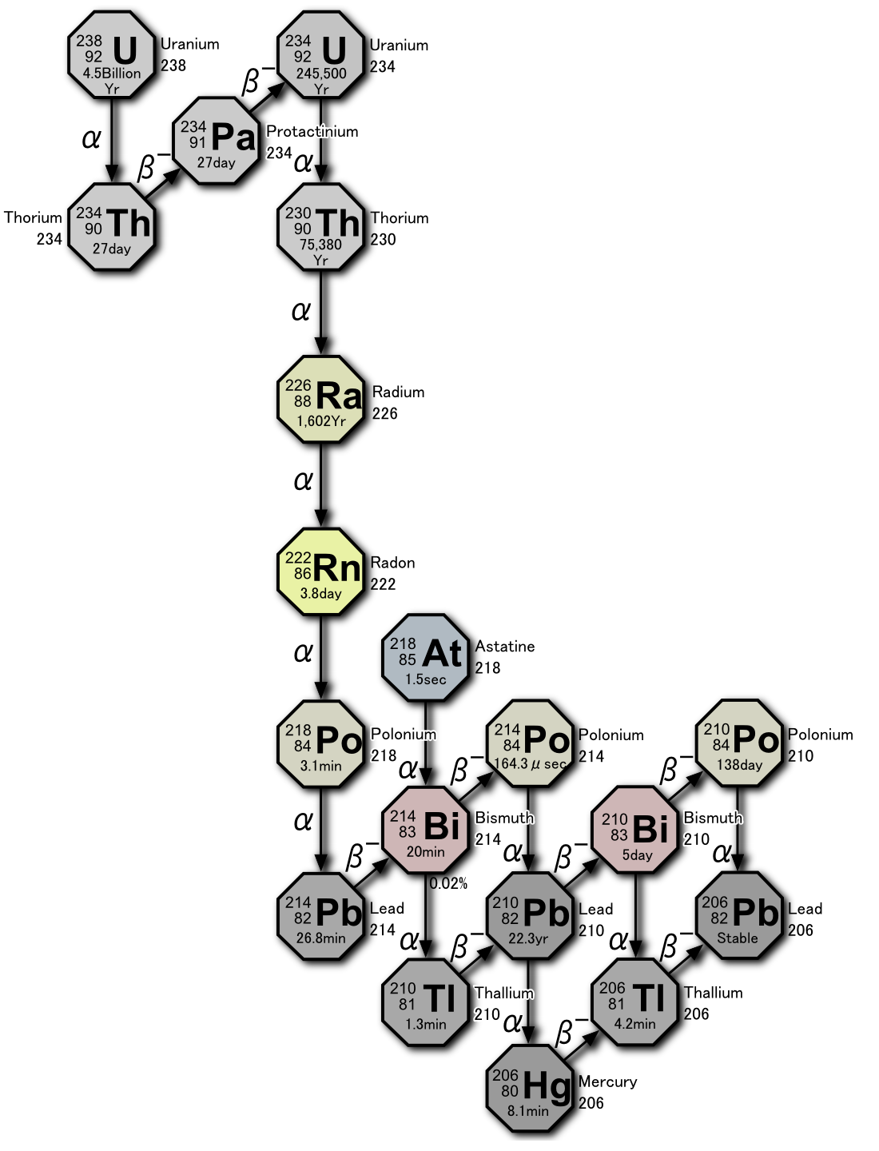
Decay Series
For uranium
Other Examples:
Uranium-lead
Samarium-neodymium
Potassium-argon
Rubidium-strontium
Uranium-thorium
Number of half-lives elapsed | Fraction remaining | Percentage remaining
0 | ¹/₁ | 100
1 | ¹/₂ | 50
2 | ¹/₄ | 25
3 | ¹/₈ | 12 | .5
4 | ¹/₁₆ | 6 | .25
5 | ¹/₃₂ | 3 | .125
6 | ¹/₆₄ | 1 | .563
7 | ¹/₁₂₈ | 0 | .781
... | ... | ...
n | 1/(2^{n}) | 100/(2^{n})
Example:
If the half-life of uranium is 4.5 billion years, how long would it take for 2 g to decay to .5 g?

Slide 5
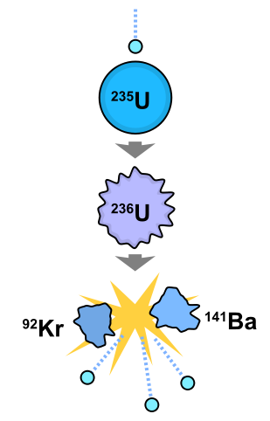
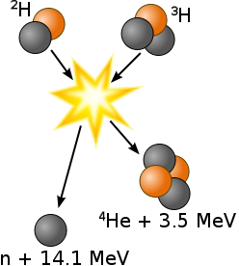
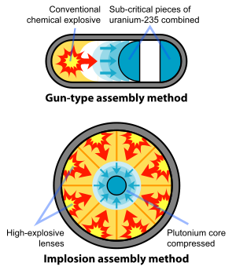
Fission – One nucleus splits apart when a neutron makes it unstable
Fusion – Two nuclei combine, become unstable and release energy
Fission Method – “Atomic bomb”

Slide 6
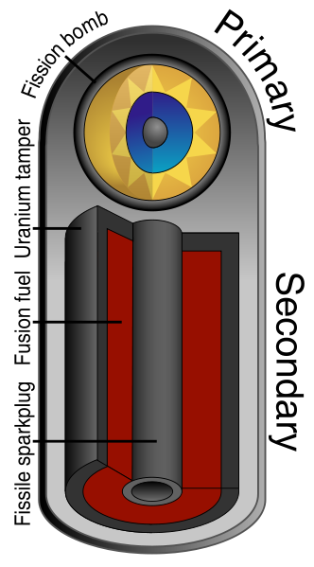

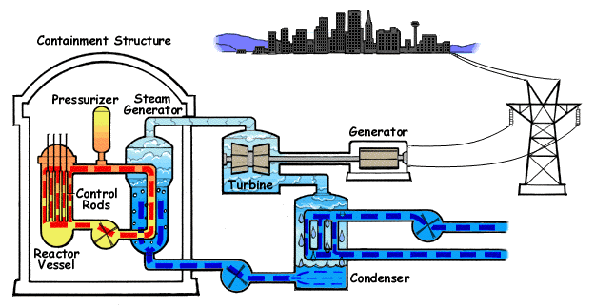
Fusion Method – “Hydrogen bomb”
Mushroom Cloud
Nuclear Reactor

