Slide 1
SUANSIAN
SUPERSONIC TRAVEL

Slide 2
TABLE OF CONTENTS
01
02
03
04
What is supersonic?
INTRODUCTION
What makes it so difficult?
DIFFICULTIES
What can go supersonic?
SUPERSONIC OBJECTS
Cha ching
ECONOMICS
05
SILLY LAND

Slide 3
01
INTRODUCTION

Slide 4
ARTICLES
https://www.rafmuseum.org.uk/research/archive-exhibitions/comet-the-worlds-first-jet-airliner/comet-enters-service/#:~:text=On%202%20May%201952%20the,4000%20km%20(2500%20miles).
https://www.nasa.gov/history/SP-4219/Chapter3.html

Slide 5
WHAT IS SUPERSONIC?
Subsonic: <Mach 0.8
Transonic: Mach 0.8-1.2
Supersonic: Mach 1-5
Hypersonic: Mach 5-10
High Hyper-Sonic: Mach 10-25
Re-Entry Speeds: >Mach 25
Supersonic speeds can vary
Notes:
Mach 1 – speed of sound (343 m/s or 768mph)
Transonic – airflow over different parts of an aircraft is between subsonic and supersonic
Ultrasonic – Frequency higher than 20 kilohertz
Sounds are waves, they travel differently in different states of matter
Ex. Water at room temperature, speed would have to reach >1440 m/s

Slide 6
CALCULATING MACH
$$M=\frac{u}{c}$$
$$c=\sqrt{γ∗R_{∗}∗T_{,}}$$
$γ$: ratio of heat of gas at a constant pressure to heat at a constant volume
R: Specific gas constant for air
T, : Static air temperature
M: Mach
$u$: Velocity
$c$: Speed of sound

Slide 7
TIMELINE
1933
1944
1947
1952
John stack
The me 262
The bell x-1
de comet
created the idea of building a high-speed plane strictly for research purposes
fighter jet began mass production but did not affect the outcome of WWII
becomes the first piloted plane to exceed to speed of sound
becomes the first commercial jet airliner, carrying 36 passengers
Notes:
1947
John Stack is awarded the Collier Trophy for his conception of transonic research in planes

Slide 8
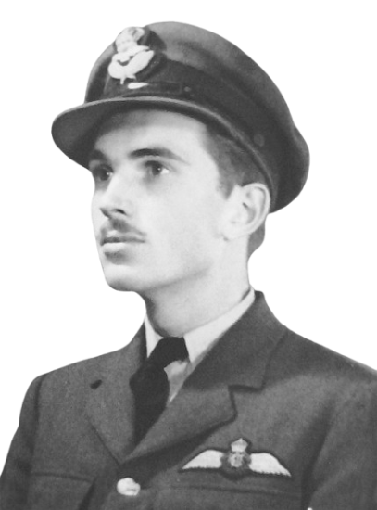
POEM BACKGROUND JOHN G. MAGEE
Born in Shanghai, China
Parents were American missionaries
Won a scholarship to Yale
Joined Royal Canadian Air Force instead
Died at age 19 due to an aerial collision in 1941
Included in the exhibition of “faith and freedom” at the Library of Congress in 1942

Slide 9
HIGH FLIGHT BY JOHN G. MAGEE
Oh! I have slipped the surly bonds of Earth
And danced the skies on laughter-silvered wings;
Sunward I've climbed, and joined the tumbling mirth
of sun-split clouds,-and done a hundred things
You have not dreamed of-wheeled and soared and swung
High in the sunlit silence. Hov'ring there,
I've chased the shouting wind along, and flung
My eager craft through footless halls of air....
Up, up the long, delirious, burning blue
I've topped the wind-swept heights with easy grace
Where never lark nor ever eagle flew-
And, while with silent lifting mind I've trod
The high untrespassed sanctity of space,
Put out my hand, and touched the face of God

Slide 10
HIGHLIGHTS
Different rhyming scheme
Religious
Sensory details
Graceful
Shows his love of flying

Slide 11
02
DIFFICULTIES

Slide 12
ARTICLES
https://simpleflying.com/why-supersonic-engines-so-complex/#:~:text=While%20variable%20inlets%20cater%20to,drag%20created%20by%20the%20inlet.
https://www.grc.nasa.gov/www/k-12/airplane/inlet.html
https://boomsupersonic.com/flyby/aerodynamics-101-the-shape-of-supersonic#:~:text=A%20supersonic%20challenge%3A%20'wave%20drag,they%20interact%20with%20aircraft%20surfaces.
https://simpleflying.com/how-jet-engines-avoid-overheating/#:~:text=Summary,them%20from%20overheating%20or%20melting.

Slide 13
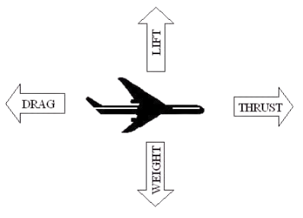
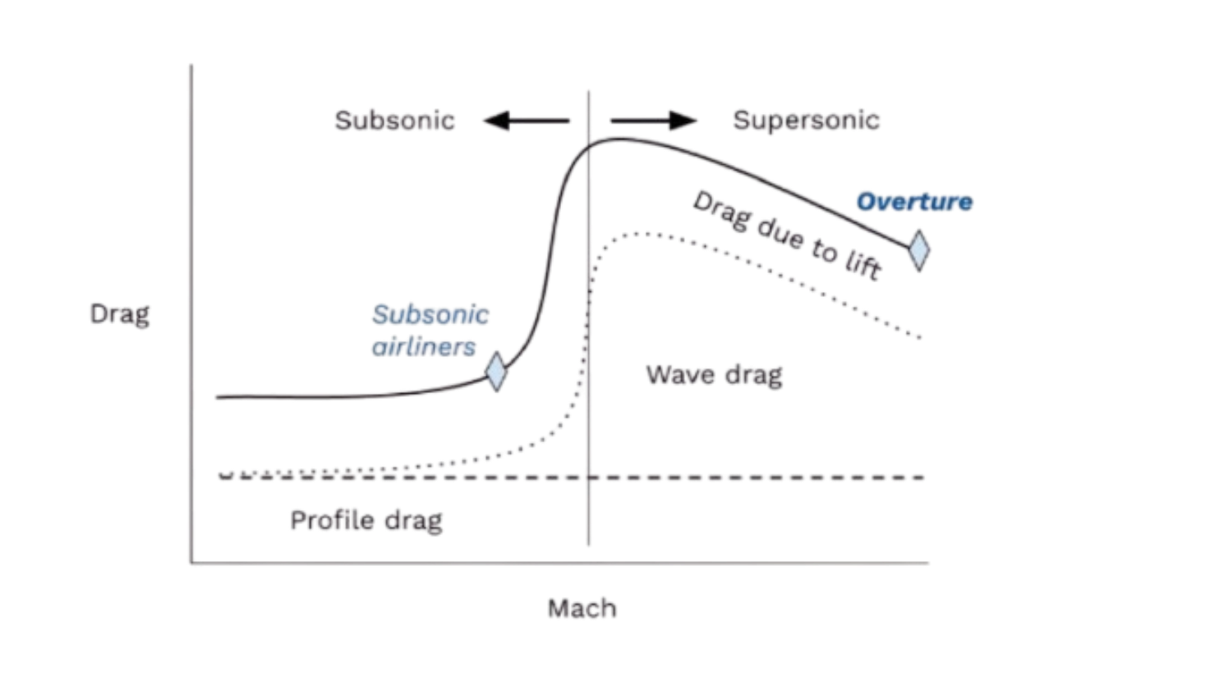
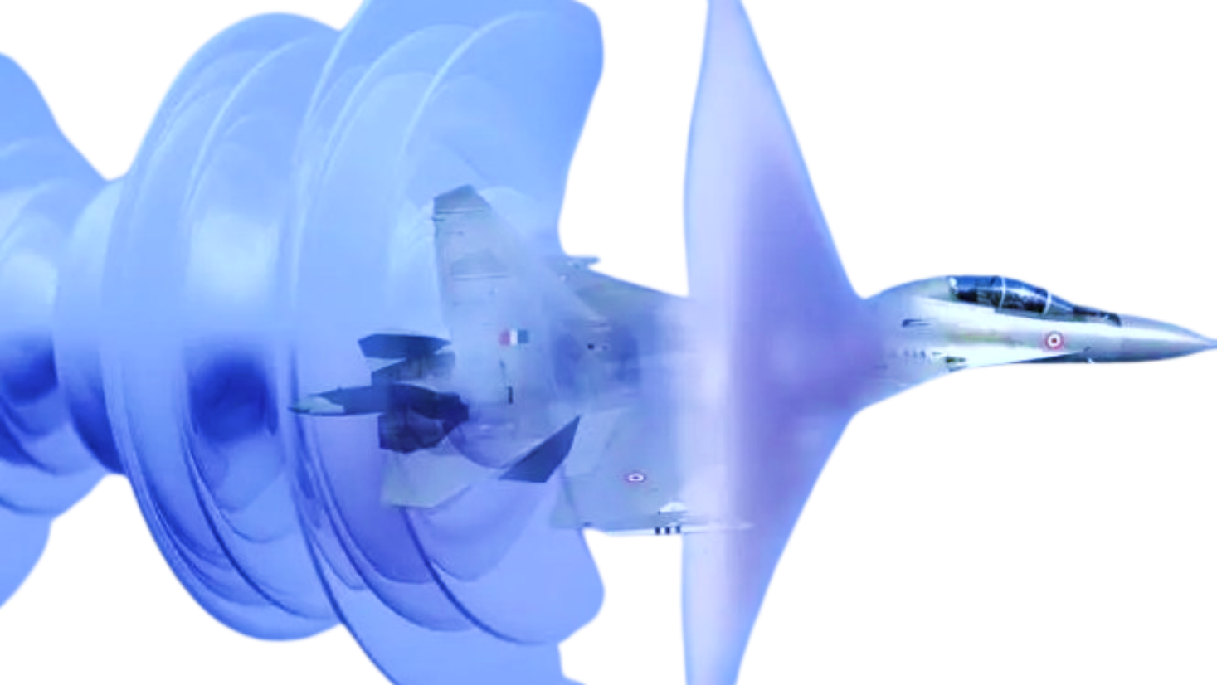
WHAT MAKES IT DIFFICULT?
Inlet determines thrust
Compressor air <Mach 0.5
Combustor air <Mach 0.2
Internal/External/Mixed compression inlets
Creates a shock system to slow air
Sonic booms
Notes:
Low combustor bc it prevents flame out
Internal + External (inside/outside)
Mixed: Only when >Mach 2
Subsonic inlets: short, smooth
Supersonic inlets: sharp
Sonic booms → Wave drag
Can increase drag by 50-100+%

Slide 15
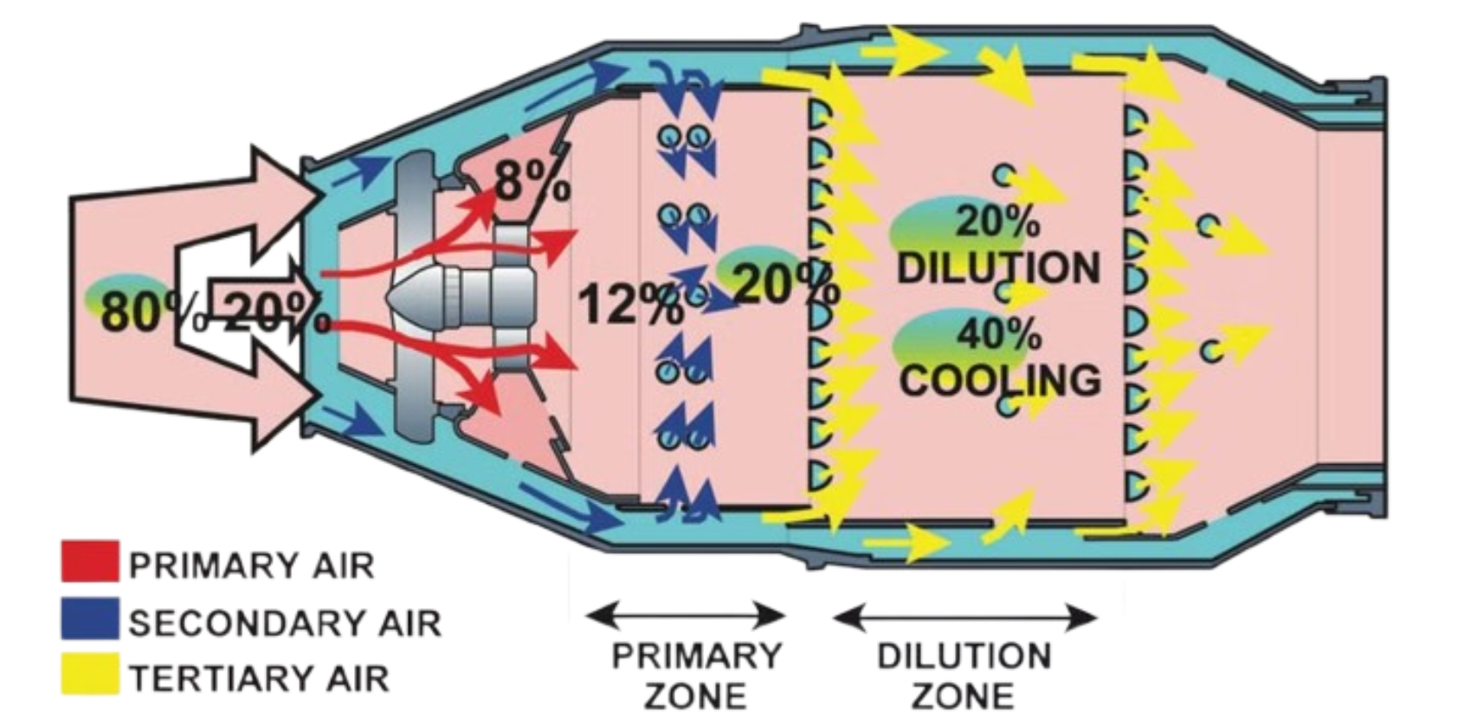
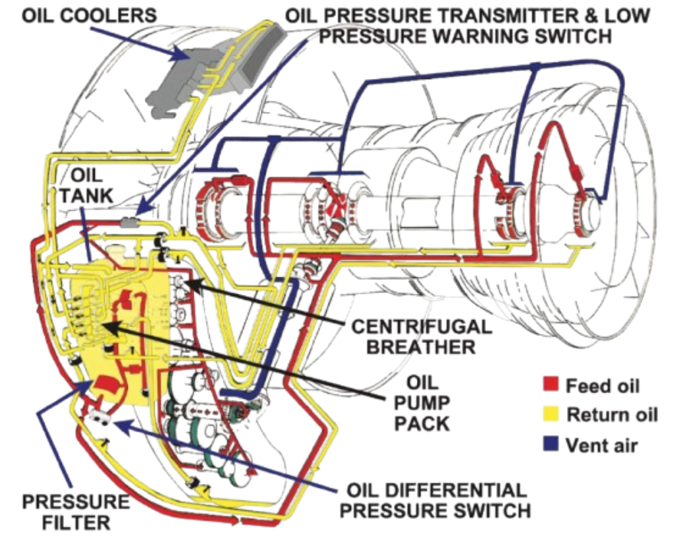
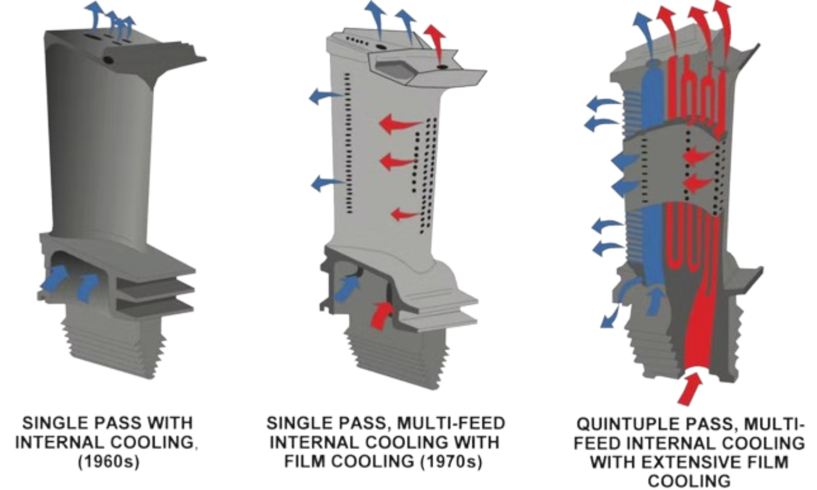
JET ENGINES
Notes:
Oil System
Oil pumped around engine
Goes through fuel-cooled oil cooler (FCOC) before going in tank
Adds heat to fuel and removes from oil
Win-win
Correct burning air to fuel ratio is 15:1
Primary, Secondary, Tertiary air
1: 20% is directly through to combustion chamber
2: 20% is around combustion called secondary air holes, reduces burn temperature and increases air molecules mixed with fuel, creates vortex which anchors flames
3: 60% goes in combustion chamber and cools the casing
@end, ratio=100:1
Ensures that the air is cool enough to avoid damage
Turbine cooling
Creep: form of stress that expands blade due to heat
Cooled by engine bleed air
Air from compressor stage is bled and fed to blades to cool them

Slide 16
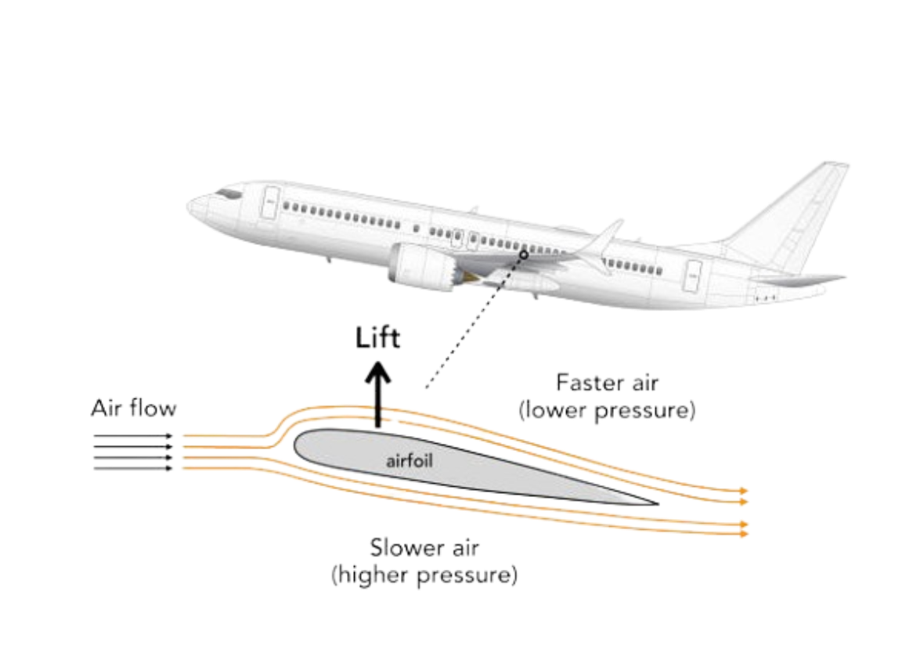
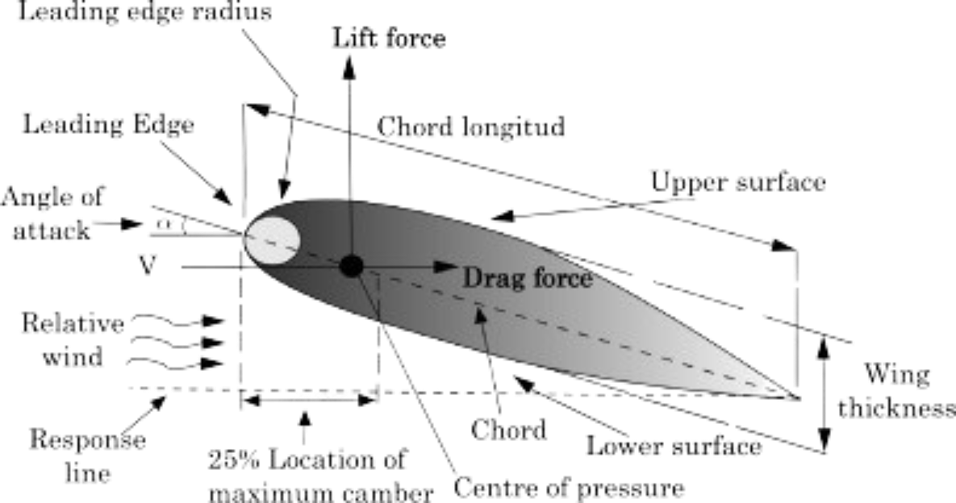
AERODYNAMICS
Slim
Sleek
Curved top of wing
Flat wing bottom
Different materials
Notes:
Smooth materials have better aerodynamics
Subsonic planes
Aluminium
Steel/Titanium alloys for important parts
Supersonic
Titanium (expensive! $$$)

Slide 17
THE INVISIBLE HAND
DO YOU THINK THE STOCK MARKET IS A RELIGION?
A metaphor for the unseen forces that move the free market economy. The concept was brought up by Adam Smith.

Slide 18
GOBBLEDYGOOK
Noun. Wordy and generally unintelligible jargon
Gobbledygook (US) – Imitation of sounds made by a turkey
As Pete lays in bed, the peaceful rhythm of his breathing eased with each rise and fall of his chest. Wrapped in the warmth of his blankets and stuffies, the world stood still with only the sound of dreams playing. Suddenly, his father tore off his blankets, shaking him awake, ranting about being late. Still in a daze, Pete couldn’t follow the gobbledygook spouting from Father Pete's mouth as he groggily stared in disarray.

Slide 19
03
SUPERSONIC OBJECTS

Slide 20
ARTICLES
https://www.investopedia.com/bullwhip-effect-definition-5499228
https://simpleflying.com/how-high-can-military-planes-fly/#:~:text=U.S.%20military%20aircraft%20can%20go,feet%20in%20record%2Dbreaking%20flights.
https://web.archive.org/web/20221210011502/https://www.nasa.gov/centers/dryden/history/HistoricAircraft/X-1/background.html
https://www.nasa.gov/reference/x-43a/#:~:text=During%20its%20third%20and%20final,for%20an%20air%2Dbreathing%20vehicle.
https://www.iwm.org.uk/history/sr-71-blackbird#:~:text=EC%3A%20%22The%20blackbird%20was%20developed,cost%20%2434%20million%20to%20make.

Slide 21
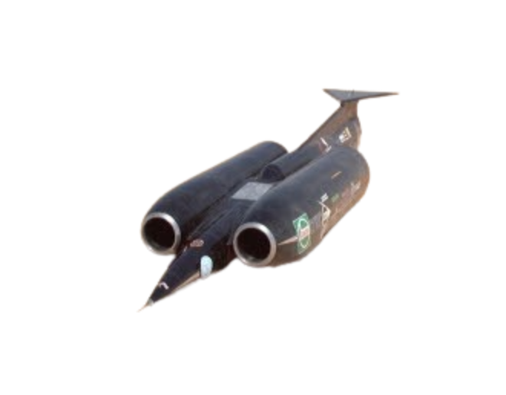
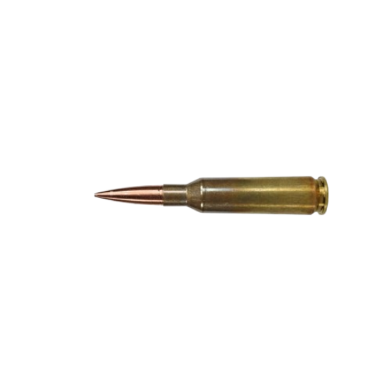
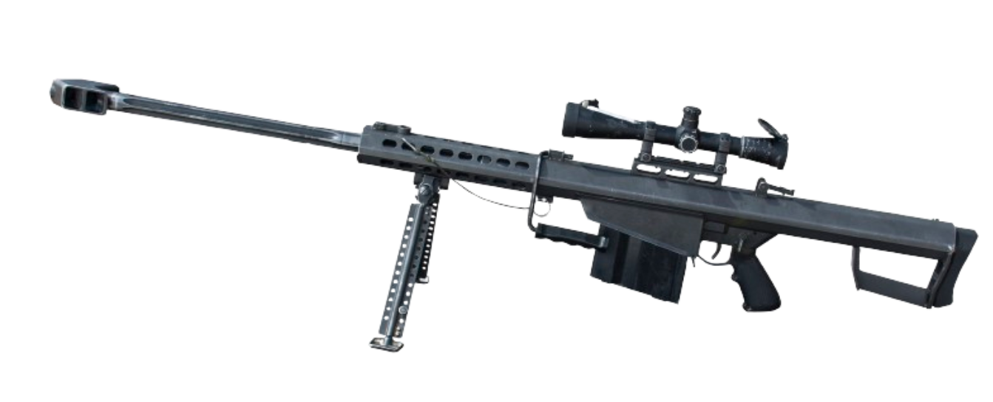
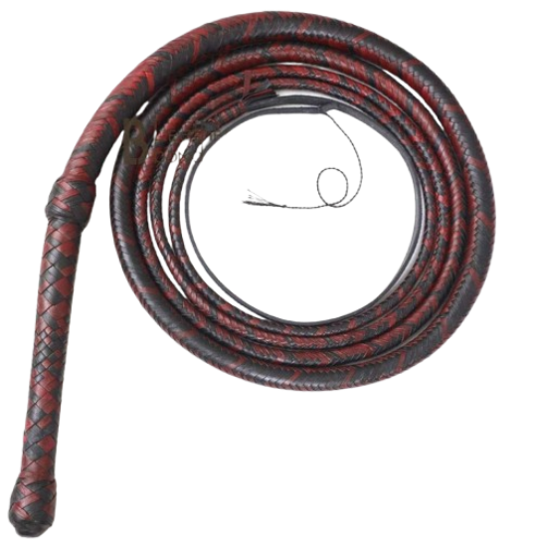
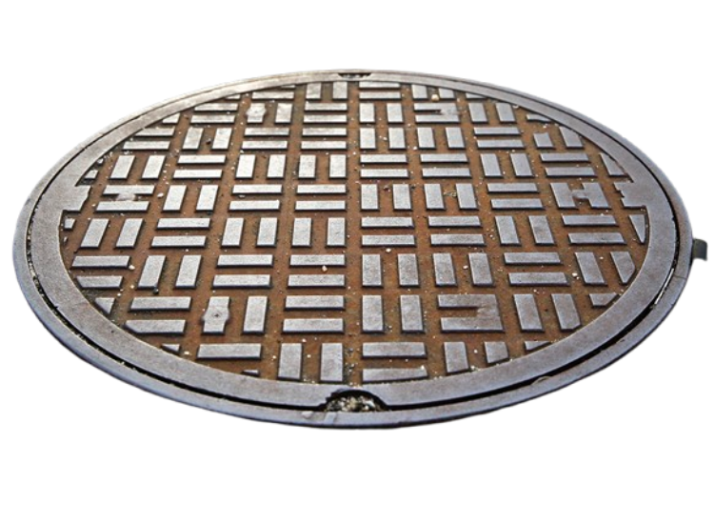
WHAT CAN GO SUPERSONIC?
Notes:
Barret M82: Narret 416 Ammo ~853m/s
ThrustSSC
763mph (341 m/s)
54ft long
10.6 tons
thrust of 223 kN ~50k lbs of force
Black Rock Desert, Nevada
2 turbofan engines also used in the British f-4 phantom II fighter jet
Burn 18 L/s (4.8 Ga/s) of fuel
Manhole Cover
Operation Plumbob
Nuclear tests underground
Pascal A, 50,000x stronger than anticipated
Recorded 1 frame per ms
Partially visible in ONE frame
Calculated to be around Mach 196 (6x Earths escape velocity)
Rockets too!
- Don’t go supersonic on launch to reduce drag

Slide 22
1550 mph
FIGHTER JETS
55,000 ft
Average Max Altitude Today
Average Top Speed Today
$19,000,000
Average Cost Today (No Mods)
Notes:
Annual maintenance for F-35 = $6.2 mil in 2022

Slide 23
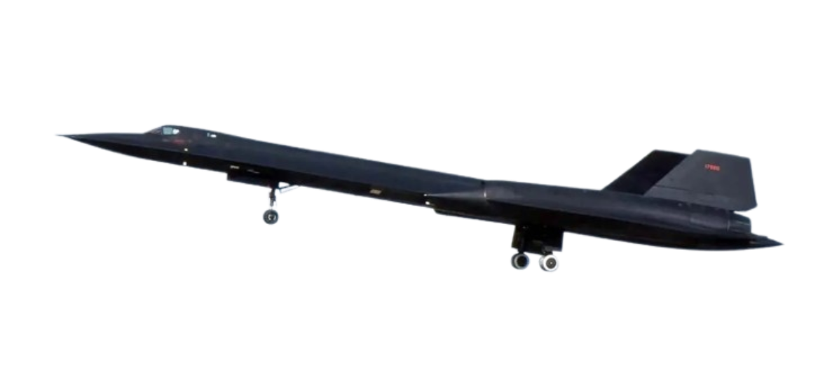
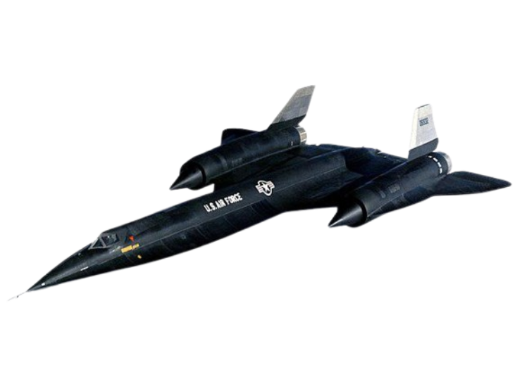
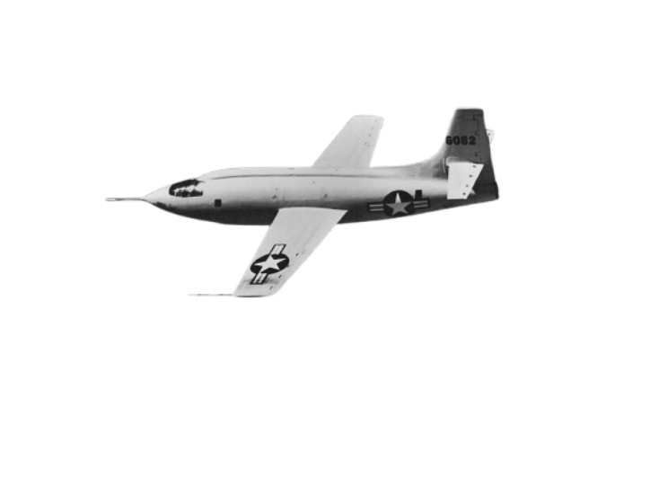
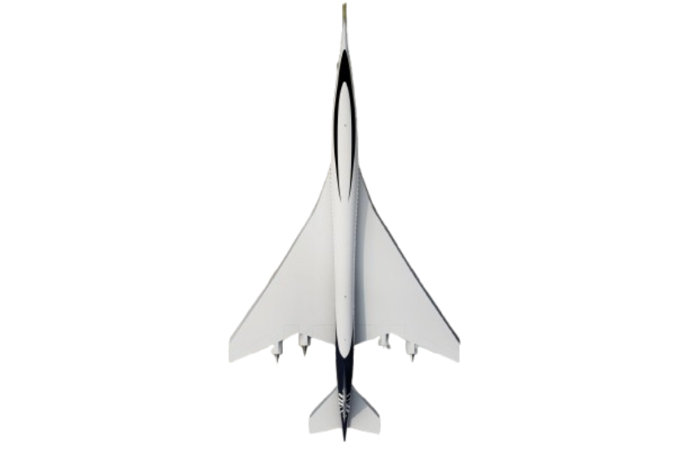
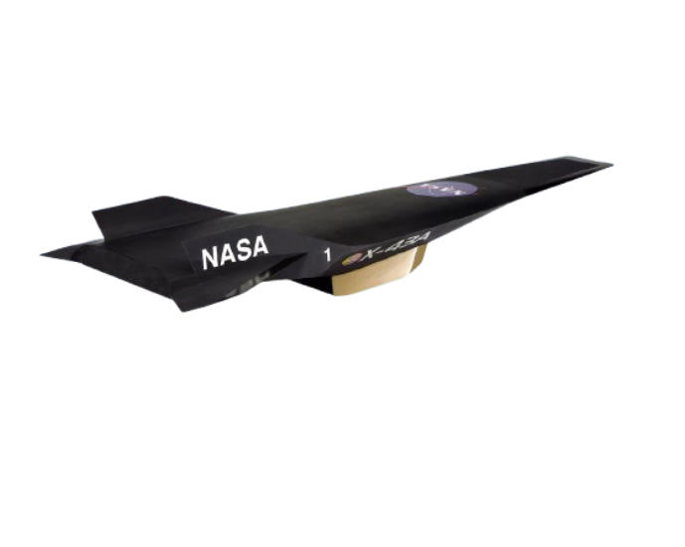
NOTABLE SS AIRCRAFTS
THE SR-71 BLACKBIRD
FASTEST MANNED AIRCRAFT
Bell X-1
First SS aircraft
Mach 1.45
$4.3 mil
72,000 ft
USAF
The Concorde
First SS passenger plane
Mach 2.04
$1.75 bil
60,000 ft
Britian + France
NASA X-43
Fastest unmanned aircraft
Mach 9.6
$230 mil
110,000 ft
DFRC
MACH 3.2
$34,000,000
85,000 FT
LOCKHEED
Notes:
DFRC: Dryden Flight Research Center in Edwards, California
Concorde: Failed (high fuel consumption)

Slide 24
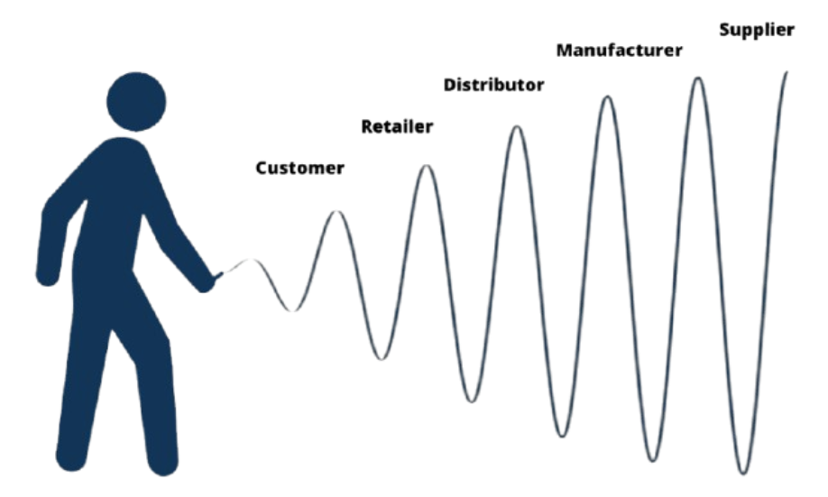
BULLWHIP EFFECT
The amplification of variability in demand when moving up the supply chain from retailers to manufacturers.

Slide 25
OENOPHILE
Noun. A lover of wine
Oinos (Greek) – wine
After collecting wine for years, Greg finally succumbed to his greed and couldn’t resist the temptation to consume the wine. Popping the cork out, the earthy aroma lingered within the air, inviting him to take a sip. One sip turned into one glass, then into a bottle. Each bottle was drained until none remained, but Greg’s oenophilic spirit craved more. He began his quest to the market by looking for his car keys. Stupefied in a drunken state, Greg’s search led to no avail.

Slide 26
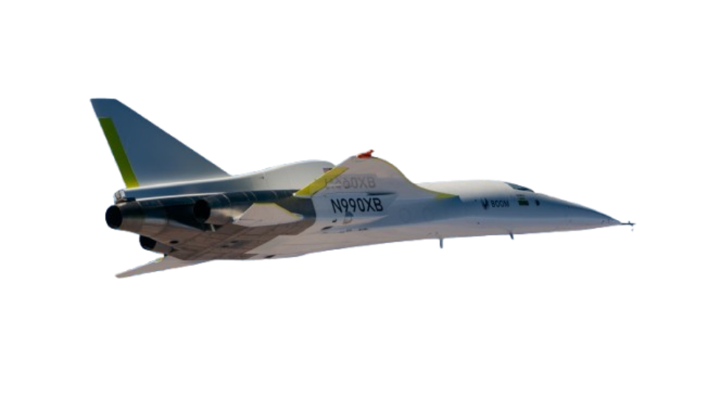
NEWS
27,716 FT
MACH 0.87
56 MINUTES
Notes:
“more people can go to more places more often” –Boom
First independently developed supersonic jet
Provides foundation for design and development of Overture plane, while setting safety as a priority
Made of carbon fiber
Three Electric J85 engines (thrust of 12,300 pounds)
9th test flight
New max speed and altitude
applied a shark skin-inspired ‘riblet’ package to XB-1’s aft underbelly for durability testing
First flight in mach 2024
12 mins in air
7120ft in air

Slide 27
04
ECONOMICS

Slide 28
ARTICLES
https://greenly.earth/en-us/blog/ecology-news/what-is-the-problem-with-kerosene
https://afdc.energy.gov/fuels/sustainable-aviation-fuel#:~:text=Sustainable%20Aviation%20Fuel-,Sustainable%20Aviation%20Fuel,how%20the%20fuel%20is%20produced.

Slide 29
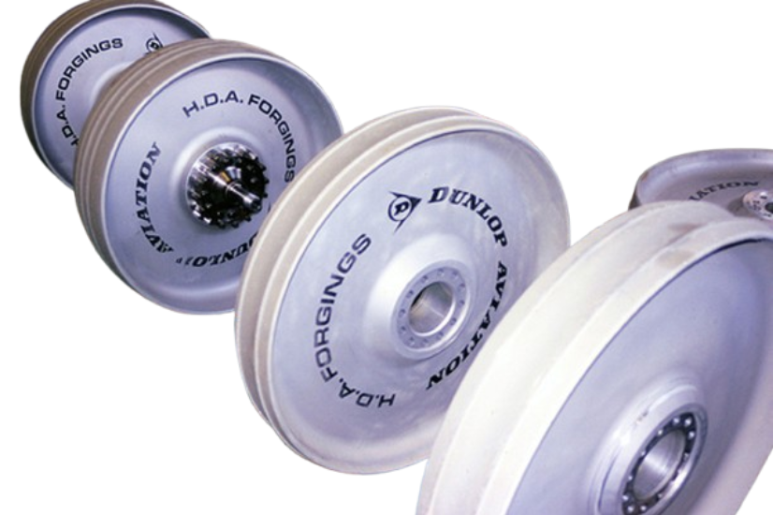
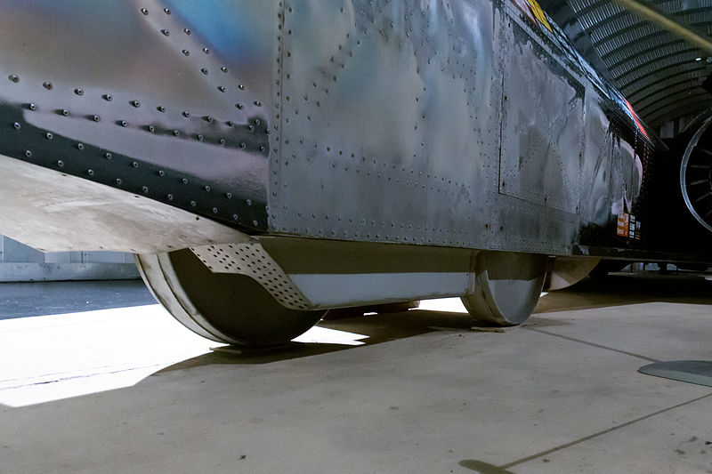
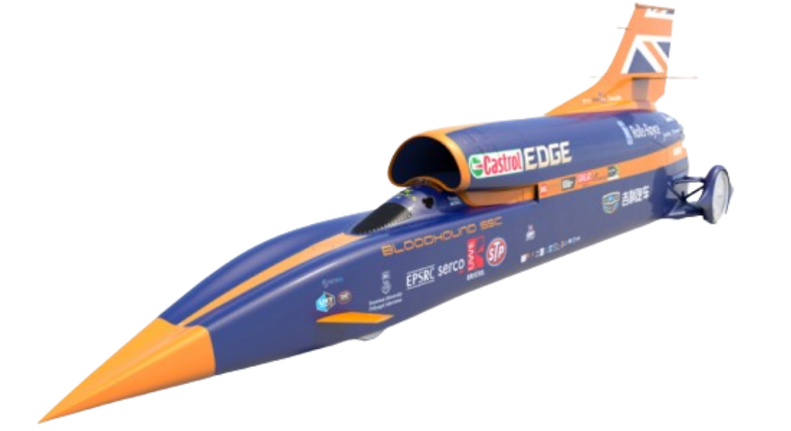
THURSTSSC CONT.
WHEELS
90 cm diameter
90 kg
10,200 rpm
Aluminium alloy
BLOODHOUND LSR
Planned for >1000 mph
Only hit 628 mph
Ran out of funding
Sold & waiting for funding
Notes:
Wheels can spin 4x faster than a f1 car at top speed
Rear wheel driving
4 wheels

Slide 30
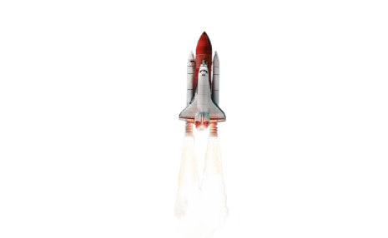
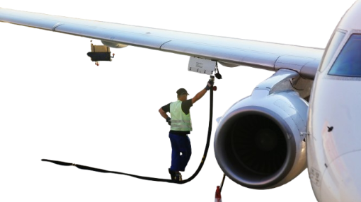
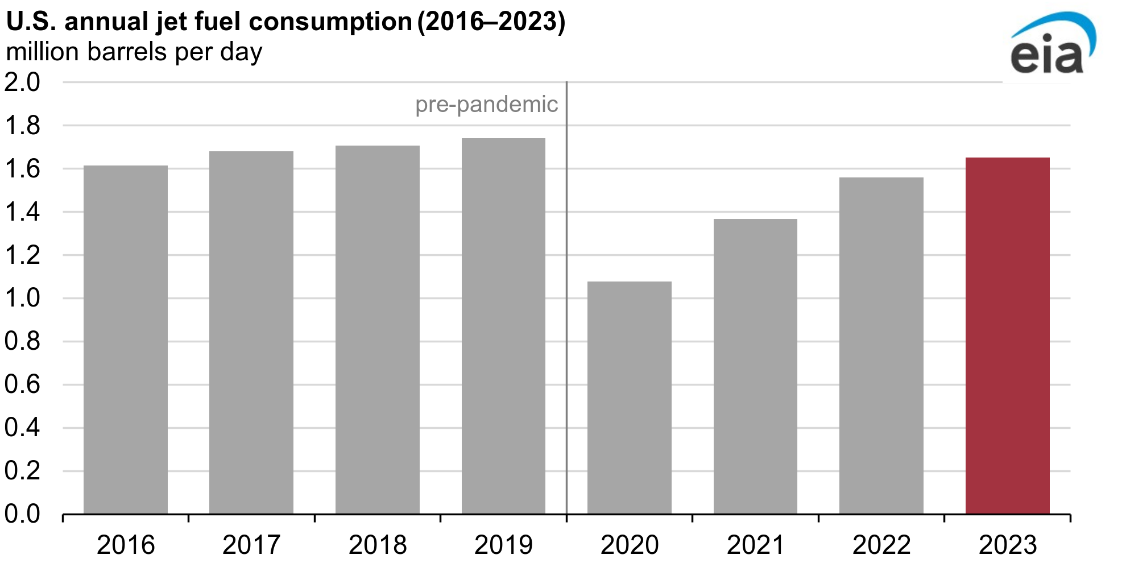
FUEL
KEROSENE
2.5-3 T/H
800-1500 G/H
5.5 T/S
LIQUID HYDROGEN
Notes:
Boeing 737 (2.5)
F-16 (800)
Two Solid Rocket Boosters (5.5)

Slide 31
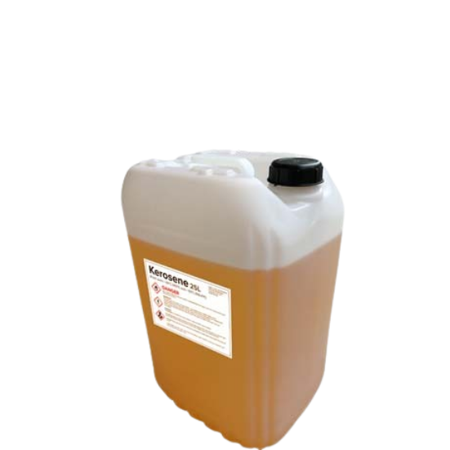
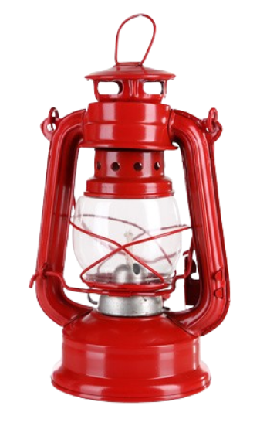
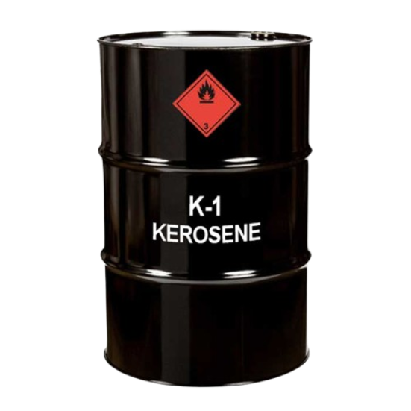
KEROSENE
PETROLEUM
$54M G/D
$20B G/Y
DIVERSE USES
3.16 KG/KG
Notes:
Petroleum: comes from crude oil, non-renewable
Can be used for cooking, lighting, heating, (fuel!)
Known oil-deposits will run out by 2052
Oil prices will continue to rise, making it economically unviable
3.16kg of co2 per kg of jet fuel
Aviation takes up 2.5% of green house emissions

Slide 32
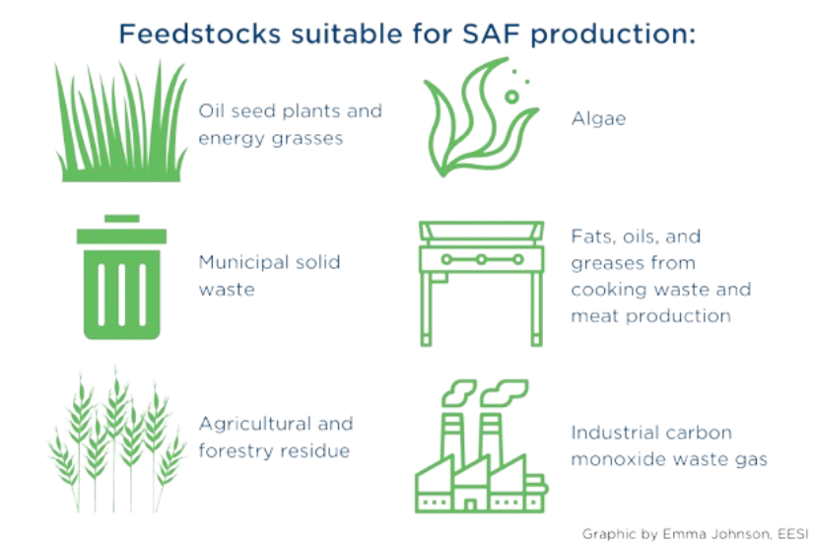
NEWS
MIXING
SUSTAINABLE AVIATION FUEL (SAF)
-94% GHG
NON-PETROLIUM FEEDSTOCKS
>360,000 FLIGHTS
46 AIRPORTS
Notes:
Can mix common jet fuel with SAF
SAF can be delivered directly to airports, increasing efficiency
AIRPORTS: US & EU

Slide 33
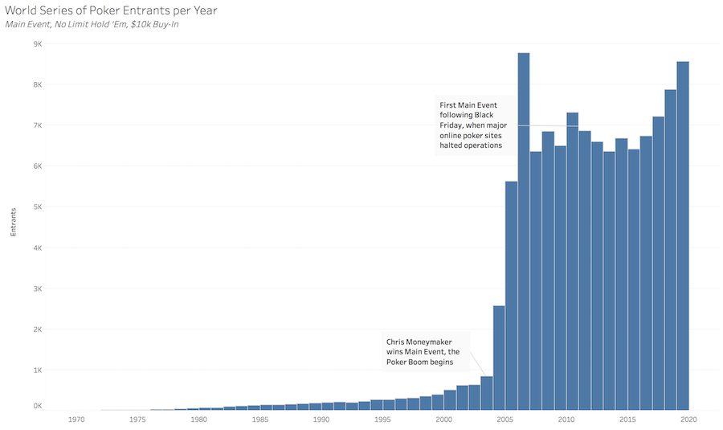
MONEYMAKER EFFECT
The Moneymaker effect is the name of the sudden growth in interest in poker after the 2003 World Series of Poker Main Event.

Slide 34
IDIOSYNCRATIC
Adj. Unique to one person
Idios (Greek) – Own, distinct
Sunkraitikos (Greek) – Mixed together
When it came to engineering a new solution, Mr. Syracuse was nothing short of extraordinary. Wrapping his fingers around his oaky pencil, idiosyncratic ideas start an endless stream into his senses, ascending his thoughts to the next dimension. These innovative views led him to be the most successful New Visons teacher of all time, often conjuring answers others have not considered.

Slide 35
05
SILLY LAND

Slide 36
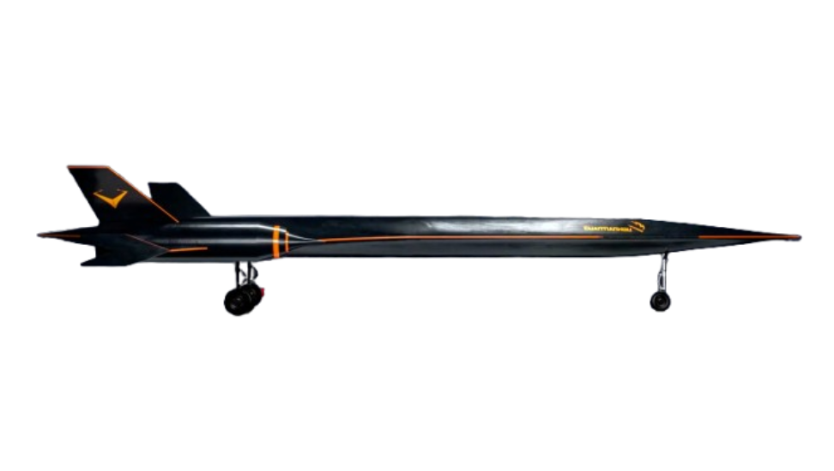
NEWS
MACH 4
2027
65,000 FT
HOLES IN WINGS
DETONATION COMBUSTION
SUCCESSFUL TESTING
$76M INVESTMENTS
Notes:
Chinese company named “Space Transportation”
Holes: Could improve aerodynamics and reduce sonic boom effects
Detonation ramjet that creates thrust (reduces weight and cost)

Slide 37
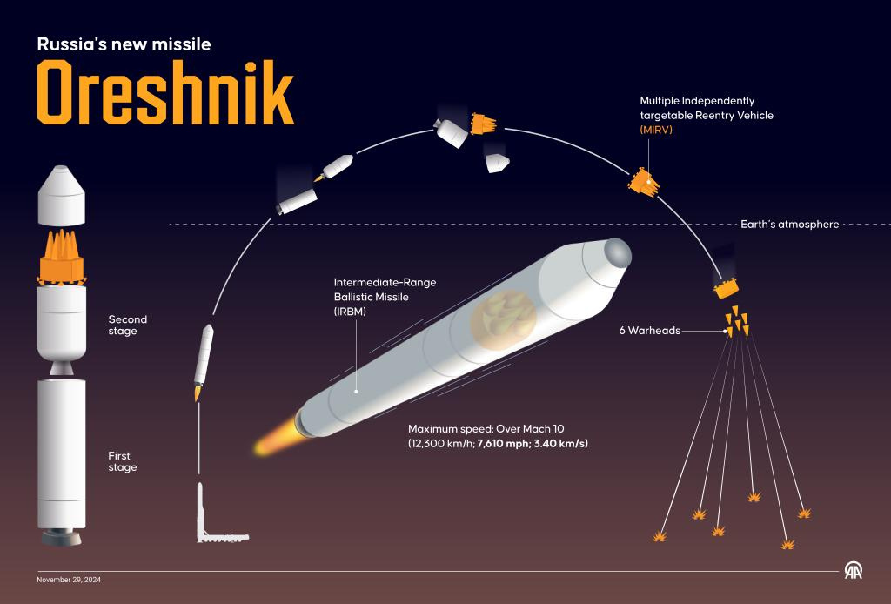
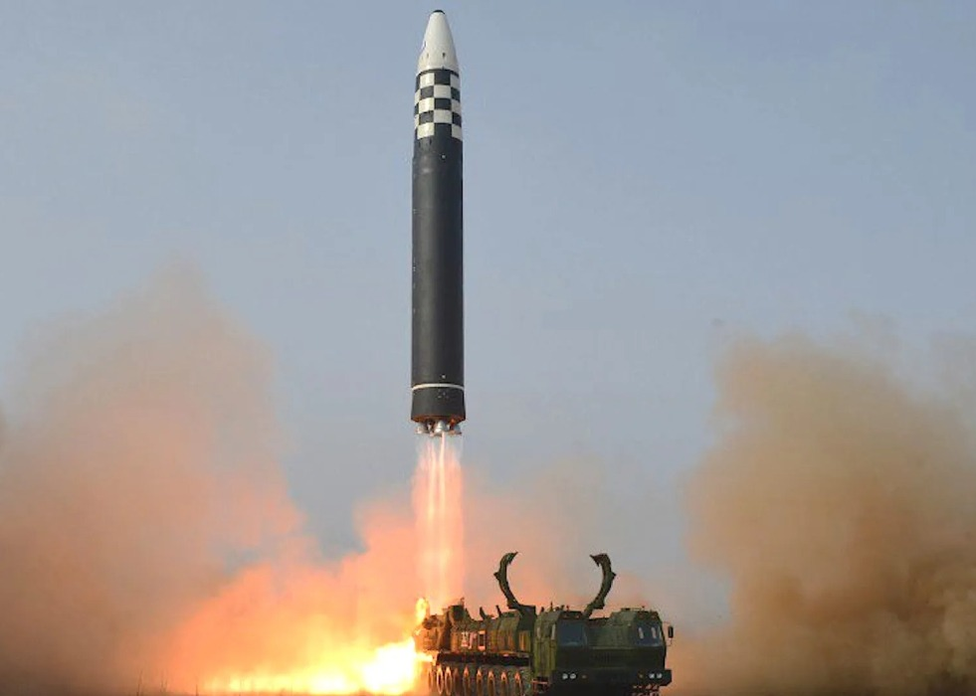
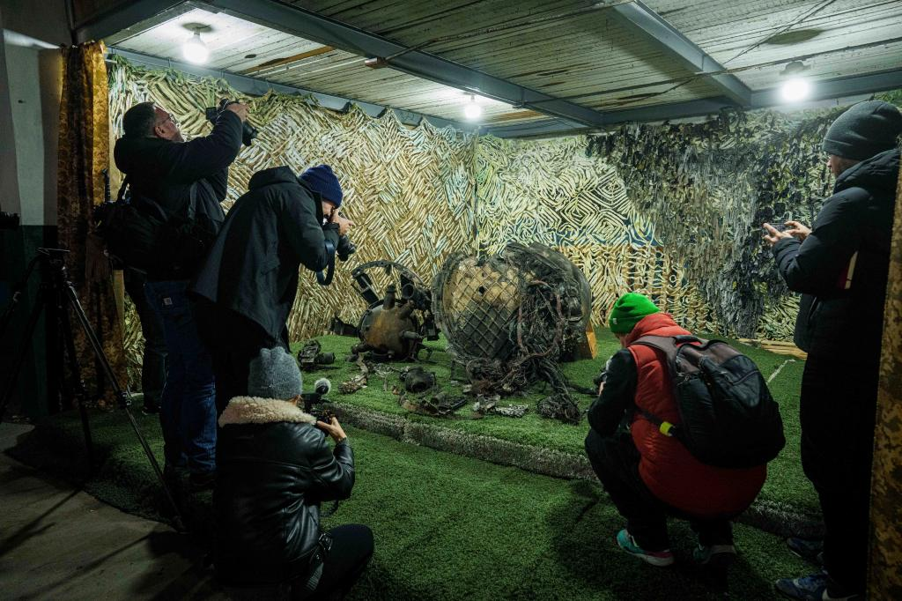
NEWS
MACH 10
MASS PRODUCTION
USED AGAINST UKRAINE
Notes:
Used last month in Russo-Ukraine war
Flies above atmosphere to be undetectable
Putin taunted the US saying we cant defend it

Slide 38
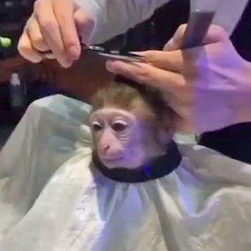
HAIRCUT
The percentage difference between what an asset is worth relative to how much a lender will recognize of that value as collateral.

Slide 39
HEYDAY
Noun. The period of one's greatest popularity
Heyday! (English) – Exclamation of joy
Seeing the new recruit, Darwizzy Jr, in action, Coach Dickinson couldn’t help but feel a deep sense of nostalgia watching him play. The contrast between his elegant movement on the ball and brutish complexion while defending reminded him of his own heyday. Seeing himself in the young lad, he knew that coaching him would be an easy task.

Slide 43
